Slide 1
‘’Transforming national potentials to social empowerment and economic advantage through IT’’
PRESENTED TO
COMPUTER PROFESSIONALS (REGISTRATION COUNCIL OF NIGERIA) CPN
By
OKEY IKPE - MBA, MCIM, EGMP HARVARD BUSINESS SCHOOL

Slide 2
Table of content
Value Proposition
Setting the Context – ’’National Potentials’’, ‘’Social Empowerment’’ and ‘’Economic Advantage’’
Some thoughts!!!!!
Information technology landscape and Social Change – ‘’Digital Age / Knowledge Economy’’
IT as an Enabler of Social Empowerment and Economic Advantage or Disruption to Traditional Social Structures with Resultant Economic Disequilibrium
Call to Action for Transformation of National Potentials through IT
  Computer Professionals in Nigeria
  Government and legislature
  Citizens
Conclusion

Slide 3
Setting the context
National Potentials
Theoretical level of real output if existing labor, capital are fully employed using best available technology
Social Empowerment
Process of creating and developing social participation and inclusion for disadvantaged persons, poor or communities
Economic Advantage
Economic theory about the work gains from trade for individuals, firms, or nations that arise from differences in their factor endowments or technological progress e.g. net income, revenue or savings

Slide 4
SOME THOUGHTS
The context raises the following thoughts:
  What are our national potentials – technologies, people, market?
  Can we measure Social Empowerment and where is the data?
  Who is accountable for disruptive Social Structures created by information technology?
  What are the interrelationships and dynamics that describe our IT Infrastructure?
  What are the institutional frameworks that foster innovation?
  What are the market dynamics that determine demand and supply?
  Are there social exclusions and barriers to entry that inhibits social empowerment and economic advantage?
  What needs to be done to transform national potentials to social participation and economic growth?

Slide 5
Value proposition
‘’The spread of information and communications technology and global interconnectedness has great potential to accelerate human progress, to bridge the digital divide and to develop knowledge societies, as does scientific and technological innovation across areas as diverse as medicine and energy” (United Nations SDG 2030 2016)’’
ICTD
Social Engineering
IT as Utilities
Safety Net

Slide 6
Information technology landscape and social change
Agrarian Economy
Industrial Revolution
Digital Age

Slide 7
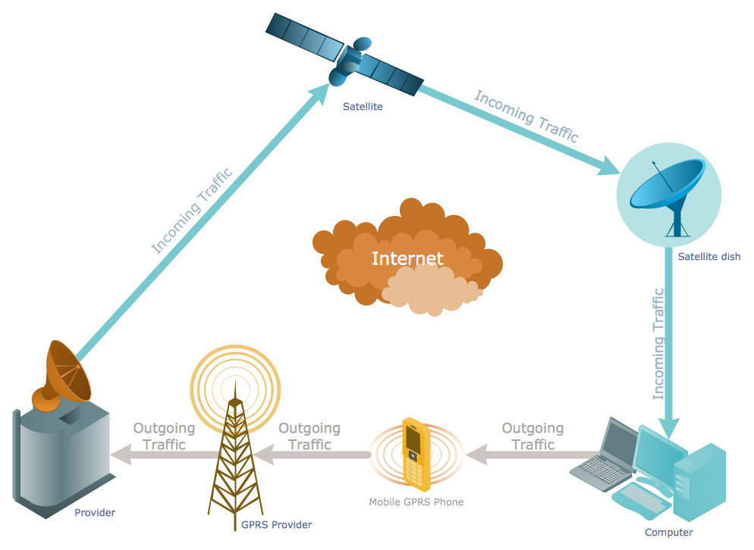
Digital age components

Slide 8
digital age attributes
Internet - Connected Networks
  Provides access anywhere, anytime
Telecommunications Networks
  Wireless
  Wired
  Satellite and
  Telecommunications Establishments
Computers – Hardware, Application Software, LOB Apps
  Personal computers, data centres
  Network Appliance, Net PC, etc.
Technologies
  IoT, Cloud Computing, Systems Technologies, Smart Cities

Slide 9
Social change – DIGITAL AGE
People
Information
Economy
Knowledge Economy
Tool
Mobile Phones
Internet
Social Structure
Digital divide
Social Media

Slide 10
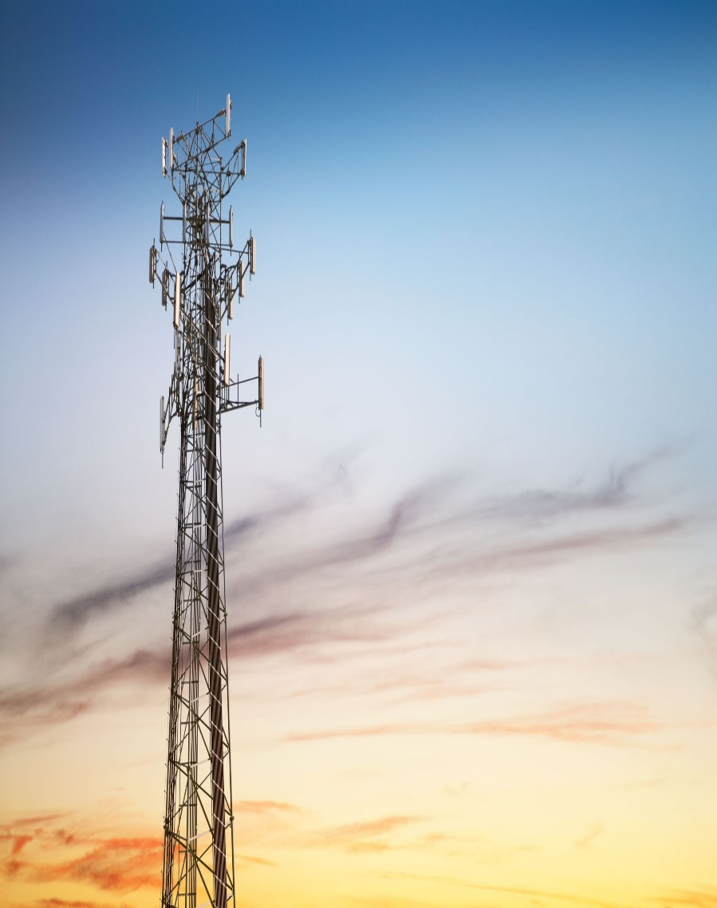
Challenges – Adoption and USE
Lack of High Quality and Affordable Infrastructure
Lack of trust in digital technologies and activities
Shortage of skills needed to succeed in digital economy
More reactive response to openness of the internet
Lack of standards and interoperability
Poor access to finance and high cost of funds

Slide 11
IT as an Enabler of Social Empowerment and Economic Advantage or Disruption to Traditional Social Structures with Resultant Economic Disequilibrium
Access | 2015 | 2014 | % Increase
Internet Subscriber Population | 97.21m (NCC 2015 | 67.10m (ITU 2014) | 44.9%
Mobile and Fixed telephony Subscriber Statistics | 151m (NCC 2016) | 139.1m (NCC 2016) | 8.5%
Sectorial Adoption of IT and Social Change (Social Inclusion VS Exclusion)
  Banking and Finance – Intermediate - matured IT adoption – Social exclusion
  SME – Basic to Intermediate – Social inclusion
  Agriculture – Basic – Social Exclusion
  Government – Basic to Intermediate – Social exclusion
  Social circle – Intermediate but over 65% of Nigeria are illiterate according to Unesco 2016

Slide 12
Measures to ameliorate the challenges
Develop a comprehensive digital strategies
Address digital security and privacy risks
Ensure and promote life learning mechanisms to improve skills
Localization and digitization of content
Reduce entry barriers
Make personal computers and infrastructure cheap and available
Accommodate standards and foreign technologies that foster knowledge transfer
Promote local competence, brand, discoveries and innovation
Facilitate access to government to citizens services

Slide 13
Measurement matrix for national transformation
Input
Output
Outcome
Impact

Slide 14
Strategic Actions to transform national potentials for social empowerment and economic advantage through IT
Social and Economic activities are increasingly migrating to the Internet;
SN | Nature of Action | Pressure Points
1. | Foundational Elements Adoption and Use | Infrastructure
2. | Functional Elements | Relevant and useful content and Training
3. | Collaborative Elements | Access, Communication and Exchange of data / Information
4. | Strategic Element – Social Empowerment and Economic advantage | Wealth creation, bridge digital divide, Quality of life
5. | Sustainability | Promote and foster social integration

Slide 15
Process and best practice mechanism – National frameworks
Initiate Guidelines
Standards
Innovation & Technology Solutions
Partnerships
People – Training and Skills

Slide 16
Strategic ACTIONS for transformation of national potentials
Computer Professionals
  Professionalism (Working for the benefit of every-one) through collaboration
  Proactive
  Commitment to digital pluralism
Government and Legislature
  Provide regulations that promote IT thereby unleashing National Potentials
  Uninformed policies and utterances out muscle IT companies
Citizens
  Use the amazing power on your finger tips wisely, judiciously and effectively

Slide 17
Nine technologies that are transforming national potentials
Autonomous Robots
Simulations
System Integration
Industrial Internet of Things
Digital Security
Cloud Computing
Addictive Manufacturing
Augmented reality
Big Data Analytics

Slide 18
CONCLUSION
‘’What I find fascinating is a measured optimism by Information technology professionals that IT is and will remain the bedrock and catalyst for innovation, social inclusion, economic transformation and internationalization of ideas and initiatives’’

Slide 19
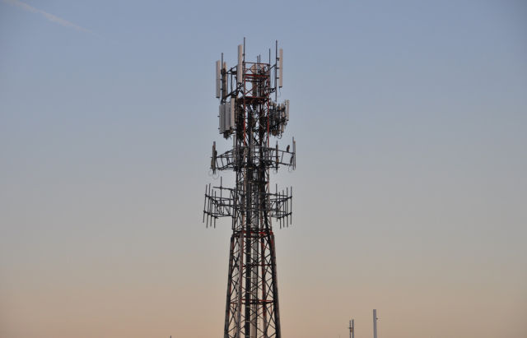
THANK YOU FOR LISTENING

Slide 20
SOME REFERENCES
International Telecommunications Union (2015), “ITU Internet Indicators 2015,” obtained from http://www.itu.int/en/ITU-D/Statistics/Pages/default.aspx 2015,”
Premium Times (2015), “Nigerian Internet Subscribers increase to 97 million”; obtained from http://www.premiumtimesng.com/news/headlines/192485-nigeria-internet-users-increase-to-97-million-ncc.html
Dean D., DiGrande S., Field D., and Zwillenberg P., (2012) “The Digital Manifesto: How Companies and Countries Can Win in the Digital Economy,” BCG. Perspectives,
Review of further implementation of the World Summit for Social Development and the outcome of the twenty first century special session of the General Assembly – E/CN.5/2005/6, para 165
Final Report of the Expert Group Meeting on “Creating an Inclusive Society: Practical strategies to promote social inclusion”, May 2008, unpublished

Slide 21
SOME REFERENCES
National Institute of Standards and Technology Special Publication SP 800-128 (2011), “Guide for Security-Focused Configuration Management of Information Systems”, August 2011 http://csrc.nist.gov/publications/nistpubs/800-128/sp800-128.pdf
Atkinson, R. D. and A. S. McKay (2007), “Digital prosperity: understanding the economic benefits of the information technology revolution”, https://ssrn.com/abstract=1004516. SP 800-14 (1996),
“Generally Accepted Principles and Practices for Securing Information Technology Systems, National Institute of Standards and Technology”, September 1996. Available on http://csrc.nist.gov/publications/nistpubs/index.html [Visited on 15, October 2015]
Guenther M. (2001) “Social Engineering – Security Awareness Series”; Information Warfare Site U.K. Available at http://www.iwar.org.uk/comsec/resources/sa-tools/Social-Engineering.pdf (Viewed on May 2016)
Vacca J. R., (2010). Managing Information Security. Syngress Publishing
Ballard M., (2006) “Government sets target for blocking child porn sites”, at http://www.theregister.co.uk/2006/05/18/uk_site_blocking/, accessed 03 January 2015
Autor, D. H. (2015), “Why Are There Still So Many Jobs? The History and Future of Workplace Automation”, Journal of Economic Perspectives, Vol. 29, No. 3, pp. 3-30.

