Slide 1
Smarter Environments with Internet of Things (IoT)
Dr. (Mrs.) Idongesit Efaemiode Eteng
Department of Computer Science
University of Calabar
Calabar

Slide 2
Outline
The Internet of Things: Definitions and the Ecosystem
The Architecture of the IoT
The Smart Environments and Generic Structure
Practical tools and technologies for building IoT-based Smart Environments
The Process of building Smart Environments
Smart Environments: The Nigerian Perspective
  The Road So Far
  Concerns to be addressed
  Bridging the gap
Conclusion

Slide 3
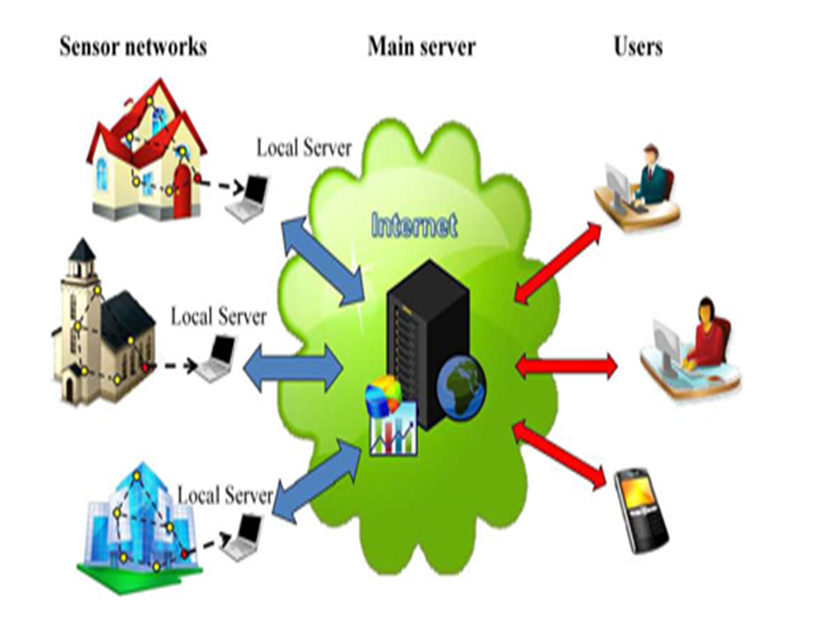
Overview of the Internet of Things
The Internet of things (IoT) is a system of inter-related computing devices, mechanical and digital machines, objects, animals or people that are provided with unique identifiers and the ability to transfer data over a network without requiring human to human or human to computer interaction.
(Wigimore, 2016)

Slide 4
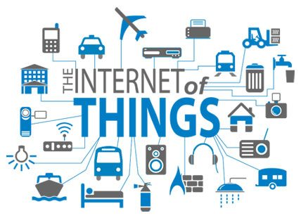
So what are things?
Now let us define things
Personal objects
Smart phones, tablet and digital cameras etc.
Elements in our Environment
Home, Vehicles etc.
Things fitted with tags (RFID or others) which become connected in a gateway device.

Slide 5
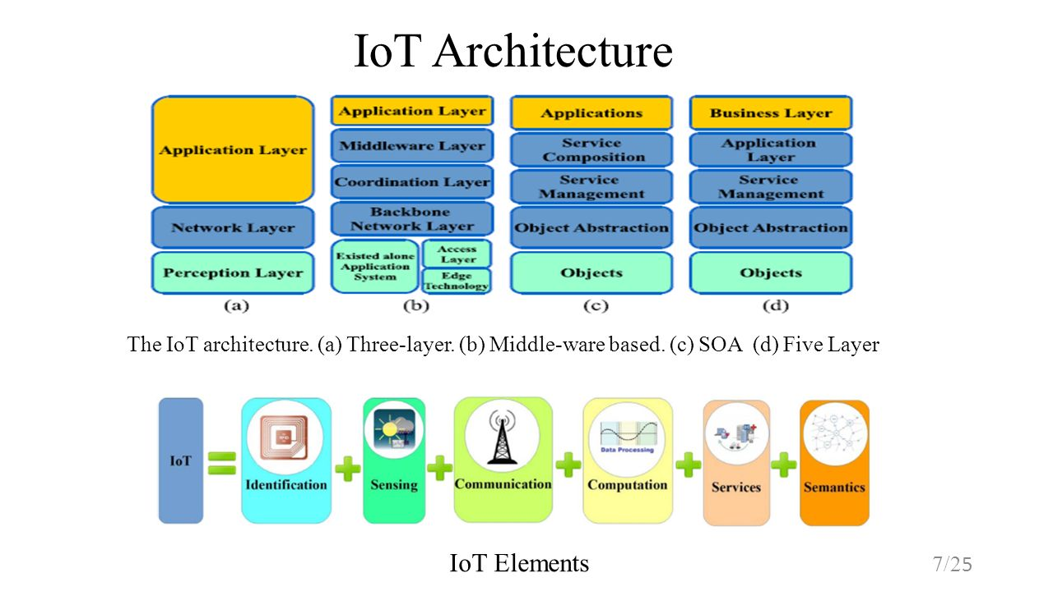
II
IoT ARCHITECTURE AND ELEMENTS

Slide 6
IoT ARCHITECTURE AND ELEMENTS:
Objects (devices) or perception layer
The first layer, the Objects (devices) or perception layer, represents the physical sensors of the IoT that aim to collect and process information.
This layer includes sensors and actuators to perform different functionalities such as querying location, temperature, weight, motion, vibration, acceleration, humidity.
The perception layer digitizes and transfers data to the Object Abstraction layer through secure channels.
The big data created by the IoT are initiated at this layer.
Standardized plug-and-play mechanisms need to be used by the perception layer to configure heterogeneous objects.

Slide 7
IoT ARCHITECTURE:
Object Abstraction and Service Management Layers
Object Abstraction Layer
Object Abstraction transfers data produced by the Objects layer to the Service Management layer through secure channels.
Data can be transferred through various technologies such as RFID, 3G, GSM, WiFi, Bluetooth, infrared, ZigBee.
Furthermore, other functions like cloud computing and data management processes are handled at this layer.
Service Management Layer
Service Management or Middleware (pairing) layer pairs a service with its requester based on addresses and names.
This layer enables the IoT application programmers to work with heterogeneous objects without consideration to a specific hardware platform.
Also, this layer processes received data, makes decisions, and delivers the required services over the network wire protocols.

Slide 8
IoT ARCHITECTURE AND ELEMENTS:
Objects (devices) or perception layer
Application Layer
The application layer provides the services requested by customers. For instance, the application layer can provide temperature and air humidity measurements to the customer who needs them.
The application layer covers numerous vertical markets such as smart home, smart building, transportation, industrial automation and smart healthcare.
Business Layer
The business (management) layer manages the overall IoT system activities and services.
The responsibilities of this layer are:
to build a business model, graphs, flowcharts, etc. based on the received data from the Application layer;
to design, analyze, implement, evaluate, monitor, and develop IoT system related elements.;
to support decision-making processes based on Big Data analysis;
the monitoring and management of the underlying four layers;
to compare the output of each layer with the expected output to enhance services and maintain users’ privacy.

Slide 9
IoT ELEMENTS: Identification, Sensing & Communication
Understanding the IoT building blocks helps to gain a better insight into the real meaning and functionality of the IoT. Functionality can be delivered by six main elements:
Identification
Identification is crucial for the IoT to name and match services with their demand.
Sensing
The IoT sensing means gathering data from related objects within the network and sending them back to a data warehouse, database, or cloud.
The IoT sensors can be smart sensors, actuators or wearable sensing devices, Single Board Computers (SBCs) integrated with sensors and built-in TCP/IP and security functionalities are typically used to realize IoT products (e.g., Arduino Yun, Raspberry PI, BeagleBone etc.). Such devices typically connect to a central management portal to provide the required data by customers.
Communication
The IoT communication technologies connect heterogeneous objects together to deliver specific smart services. Typically, the IoT nodes should operate using low power in the presence of lossy and noisy communication links.
Examples of communication protocols used for the IoT are WiFi, Bluetooth, IEEE 802.15.4, Z-wave, and LTE-Advanced.

Slide 10
IoT ELEMENTS: Communication & Computation
Computation
Processing units (e.g., microcontrollers, microprocessors, SOCs, FPGAs) and software applications represent the “brain” and the computational ability of the IoT.
Various hardware platforms were developed to run IoT applications such as Arduino, Intel Galileo, Raspberry PI, etc.
Services
Where services are provided
Semantics
Adding meaning to content

Slide 11
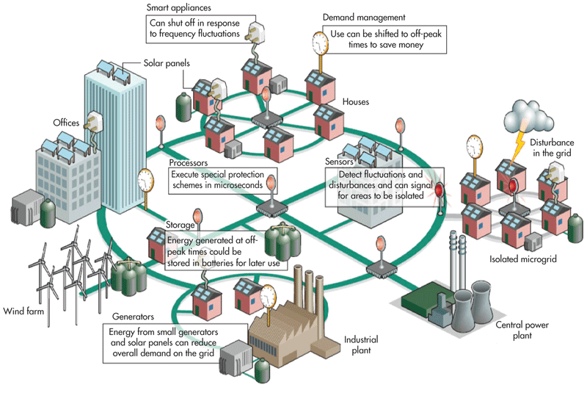
SMART ENVIRONMENTS
A Smart Environment is a world where all kinds of smart devices are continuously working to make users’ lives more comfortable (Cook, 2005).

Slide 12
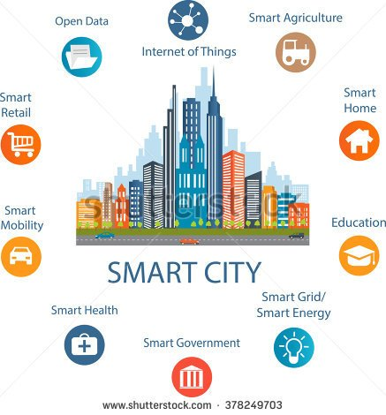
Smarter Environment: Smart cities
Smart Environments are currently considered a key factor to connecting the physical world with the information world. A Smart Environment can be defined as the combination of a Physical environment, an infrastructure for data management (called Smart Space), a collection of embedded systems gathering heterogeneous data from the environment, and a connectivity solution to convey these data to the Smart Space.

Slide 13
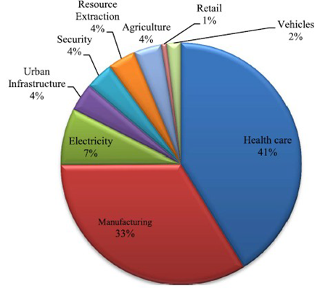
Smart Environments cont’d : Average distribution of components
Smarter Environments have come to stay

Slide 14
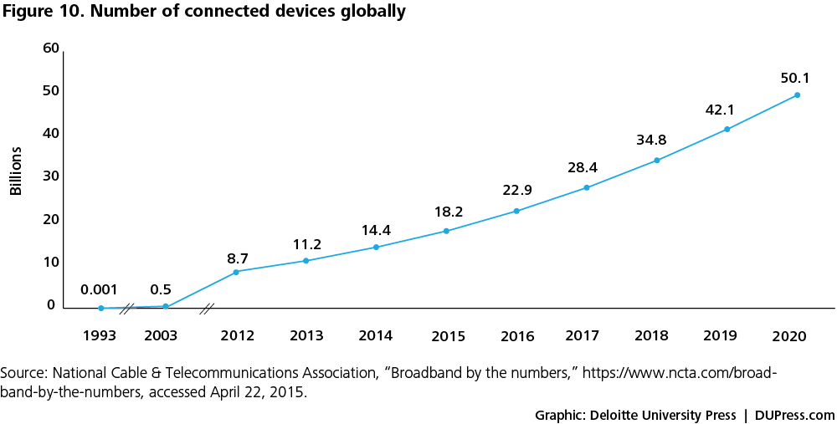
Smart Environments cont’d: Connected devices

Slide 15
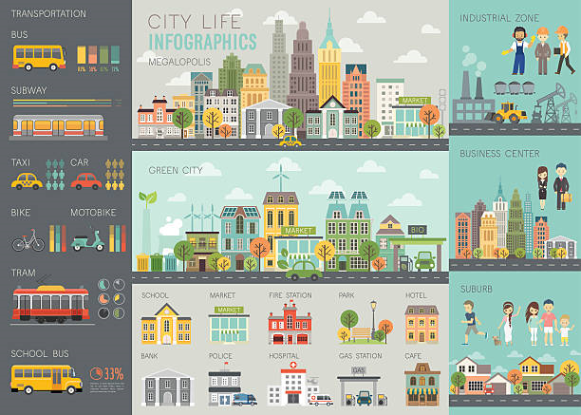
Generic Architecture of Smart Environments
Architecturally, a smart community consists of three domains:
The home domain
community domain
and service domain

Slide 16
Generic Architecture of Smart Environments : The Home Domain
A home network is formed by a number of home automation systems (e.g. Healthcare systems and security systems) for continuous real-time monitoring of residents.
These systems report their surveillance results to a home gateway inside the home in a single-hop or multi-hop way.
The connection may be realized by powerline communication technologies such as HomePlug, wireless communication technologies like Bluetooth, phone line communication technologies such as HomePNA
other technologies such as Ethernet that require dedicated wiring.
The gateway is the home’s communication interface with the outside world.

Slide 17
Generic Architecture of Smart Environments : The Community Domain
The core of the smart community architecture is:
  the community domain, where a connected community network is formed by home gateways (representing their hosting homes) for cooperative and distributed monitoring of the community environment and information dissemination among individual homes.
  A reliable wireless device, called a community center, is placed in the network for data storage and processing. It is guarded by advanced sensor technologies and protected by defensive layers; unauthorized access will trigger alarms, notifying community residences and authorities.
  Home gateways and the community center are connected wirelessly using WiFi links in a multi-hop manner.

Slide 18
Generic Architecture of Smart Environments : The Service Domain
The key component of the service domain is a call center, which is a communication and computation device hosted by a trusted party like a local police department.
It receives service calls from the community domain by being connected to individual homes (the corresponding home gateways).
The service domain dispatches the service calls to proper authorities or service providers, through a reliable communication channel such as the public telephone system or television cable system.
It is connected to the community center as well.

Slide 19
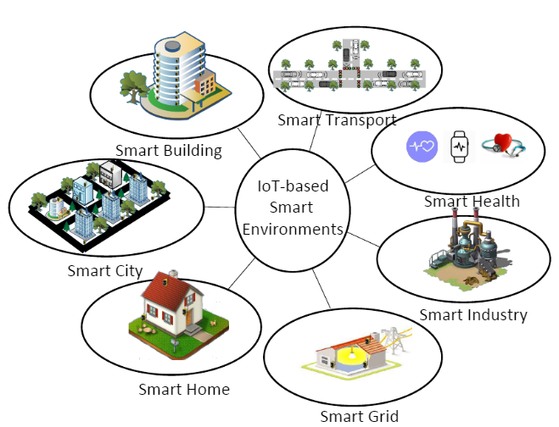
Other components of a smart environments
Other aspects of the Smart Environment are discussed as regards the Nigerian Setting.

Slide 20
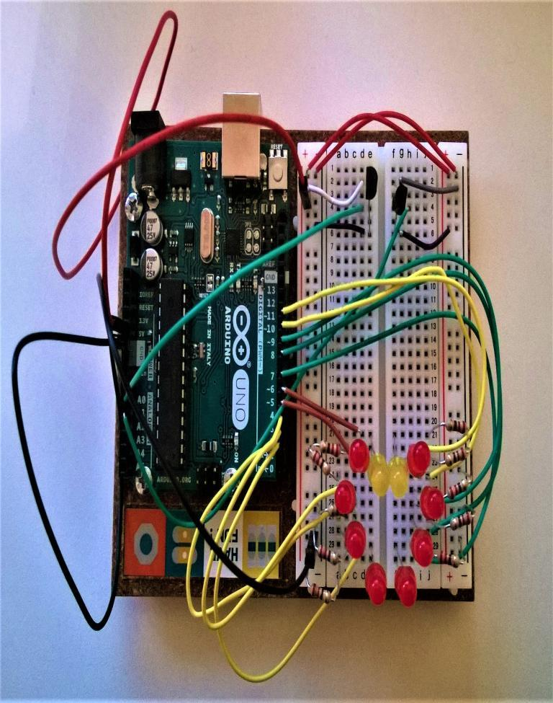
Start small: Basic equipment needed to demonstrate the building block for Smart Environments
A development board with a microcontroller: this has both interphases and chips e.g. Arduino, Raspberry Pi
Connectors
Input devices (sensors)
Output devices (actuators)
A breadboard for wiring

Slide 21
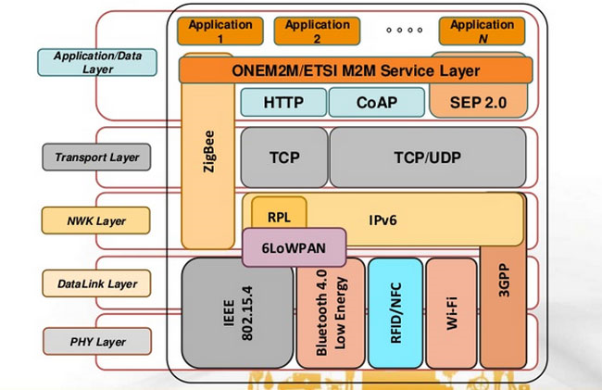
Basic Protocols needed for building IoT-based Smart Environments

Slide 22
The Process of building Smart Environments
The Delloite Press in 2016 published a primer that itemizes process for building Smart Environments. They are
Create: Using smart sensors to collect data from the environment
Communicate: Transmission of the data from relevant sensors through gateways to needed locations
Aggregate: Gathering information created from different sources and ay different times.
Analyze: Discerning patterns and relations among data for predictive, descriptive and other analytics for decision making
Act: Initiating, maintaining and changing physical events or state consequent upon analytics or other

Slide 23
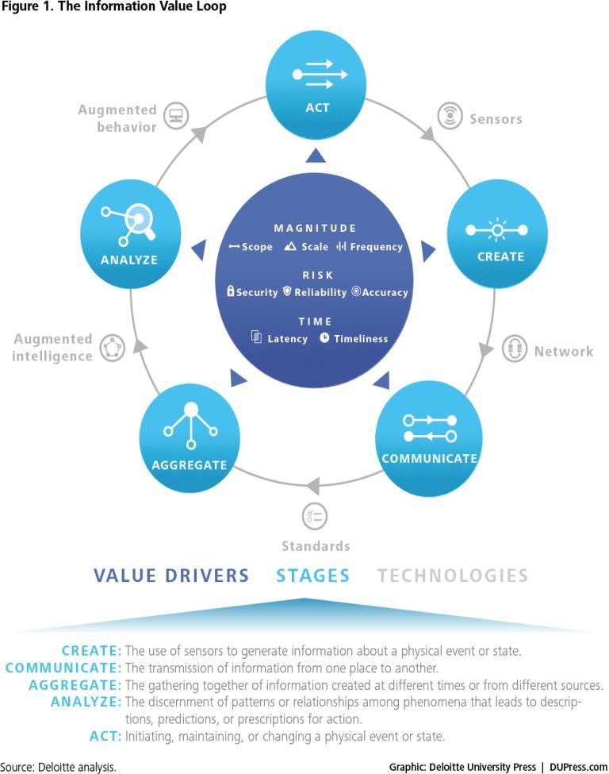
The Process of building Smart Environments continued

Slide 24
The Process of building Smart Environments: Practical business approach
Gathering of major stakeholders and deciding the goals of the Smart Cities
Policies and Procedures governing the Smart Community must be drawn out
Proper categorization of government agencies and sub goals
Creating context profiles and dictionaries of profiles
Streamlining Information flow through gateways
Ensuring that data are properly and securely channeled.

Slide 25
SMART ENVIRONMENTS: The Nigerian Perspective
This month (June 12, 2017), the Daily Trust announced that the Minister of Communications, Barrister Adebayo Shittu is prepared to launch the Nigeria Smart Cities Initiative. This should be going on about now. 28th -29th June, 2017
The Minister, in a Press Conference in Abuja, stated that the Smart Cities Initiative will serve as an opportunity to demonstrate how IT can be linked with the physical infrastructures of various sectors of the economy while enhancing Nigeria IT innovations to deliver business and public needs. The Minister, in his speech admitted that this project will not be an easy one due to the lack of critical infrastructure, while showing the government’s will to address these challenges.
Taking a look I.C.T. infrastructure in Nigeria, let’s see how prepared Nigeria is for the initiative.

Slide 26
SMART ENVIRONMENTS: The Nigerian Perspective The Road So Far
Reports from the Internet world statistics gives the following details about Nigeria:
Internet users in Nigeria as at 31st December, 2000 was 200,000
Penetration of population is less than 50%
Facebook subscribers 16,000,000
Nigeria accounts for a low percentage of Internet use on the continent
We seem to be making a bit of progress but there are concerns

Slide 27
SMART ENVIRONMENTS: The Nigerian Perspective The Road So Far
E-Commerce
Jumia Nigeria
Leveraging on high ICT tools to boost consumer confidence.
The customer can track the location of the purchased item to see if there is any progress.
This is still semi-automated
Uber Nigeria
The customer launches the Uber mobile app
He views his current location and searches for his preferred destination
Places an order
Waits for a call from a driver close by
The driver picks the order and the customer can view the driver moving towards his direction

Slide 28
SMART ENVIRONMENTS: The Nigerian Perspective The Road So Far
Wearables
Home Appliances
Fitbits smart watches
Smart glasses
Smart Headphones
Samsung Smart Oven
LG Smart Oven
High Sense 7kg Smart Control Front Load Washing Machine
Gencool Smart Inverter Split Unit Air Conditioner
Smart Home Wireless IP Camera

Slide 29
SMART ENVIRONMENTS: The Nigerian Perspective The Road So Far and CONCERNS
How efficient is our cloud service?: Galaxy Backbone was launched in 2006 yet there is still a dependency on paper in most agencies.
Smart Cities come with appropriate supervision by the government through the security agencies. We need effective CCTV coverage in strategic positions
How affordable is the Internet access? Now we will be using more than smart phones.
How readily accessible is data on all individuals?
Internet usage is still low in most Nigerian communities.
There is a difference between smart environments and using smart objects.
The Internet literacy level is still low.
Internet cost still not affordable by most citizens.
Security and privacy issues in creating smart cities is still a big challenge even globally

Slide 30
The way forward
recommendations
Increasing Internet usage and coverage in various communities.
Make our cloud Service efficient
Launching WiFi networks in various communities across the country.
Create awareness about Smart Environment.
Create research groups to handle key challenges like security, interoperability, power consumption.

Slide 31
Add a Slide Title - 1
THANK YOU

Slide 32
References

