Slide 1




2016 Information Technology Professionals’ Assembly
IT Development in Nigeria:
Learning from Past Experiences
Presentation by:
John Tani Obaro
MD/CEO, SystemSpecs

Slide 2
Outline
Evolution of IT in Nigeria
Impacts of IT Development in Nigeria
Challenges of IT Development in Nigeria
Lessons Learnt
Way Forward
Proposed Benefits to Nigeria
IT Development in Nigeria: Role of CPN
Role of SystemSpecs

Slide 3
TSA Success Story
“…I can assure that our experience has been worthwhile.
TSA has provided complete and timely information on
government cash resources, improved operational control
on budget execution, enabled efficient cash management,
reduced bank fees and transaction costs, facilitated
efficient payment mechanisms and it has also reduced
the FGN ways and means requirement to bridge
the budget funding gap.”
– Minister of Finance, Mrs. Kemi Adeosun

Slide 4
How Nigeria Kills Her Own
On the Implementation of the Treasury Single Account (TSA) Policy of the FG:
“In spite of the initial relative advantage the bespoke solution, as Remita, could have over the globally accepted Commercially available Off The Shelf (COTS) software like SAP, Oracles Financial, Epicor, Navison, etc., a desirable strategy is a two-step approach that starts with the locally designed bespoke software solution and transiting to the more sophisticated and test COT.”
Section 6.3.2 of the Senate report on TSA

Slide 5
Over the years…
  We have not:
  invested in and encouraged Research and Technologies based on Knowledge & Information Production and Dissemination; and aspects often considered as ‘Intangibles’.
  invested in Skilled Workforce, constantly upgrading their knowledge-base and filling the void.
  prioritized productive entrepreneurship.
  driven policies, incentives and actions to encourage constant and rapid knowledge acquisition.

Slide 6
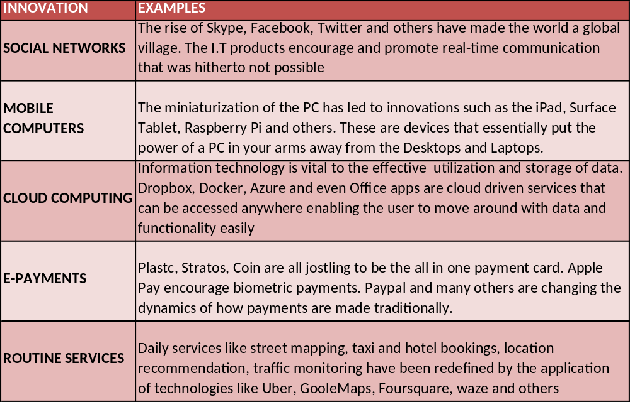
Global Innovations in Information Technology

Slide 7
The Nigerian Story: Major Milestones
1920s–40s
Newspapers
Television
1980s–1999
Wired telephone systems
1950s–70s
Photography
Printing technology
Typewriters
Fax
2000 – till Date
Electronic web
Computers
Internet
Electronic mail
Social media
Smart phones
Mobile telephony
Electronic payments
Internet
Web collaborations
Postal services
Cinemas
Video cassette players & discs
Radio

Slide 8
Impacts of IT Development in Nigeria
AGRICULTURE
Revamping fertilizer/seedling allocation processes in Nigeria: i.e. The government initiative with e-Tranzact on the fertilizer project shows how I.T. can be leveraged to develop the agricultural sector.
GOVERNMENT
Transparency in government spending and earnings: A pivotal government scheme like TSA is driven by Remita (a private enterprise) which has helped ensure transparency and accountability in the system.
E-COMMERCE
I.T INDUSTRY
Emergency of local solutions: Developments in I.T. have prompted Nigerian firms to now foray into software services geared towards mobile users, e.g. MTECH, Kuluya, wetin dey etc.
Growth of eCommerce: IT has been central to the development of e-Commerce and the economy. Konga, Jumia, DealDey, Kaymu and a host of others are using I.T. to power e-Commerce platforms
COMMUNICATION
Improved communication: Innovations in I.T have changed our social interactions with social media, mobile telephony, emails ad other have broken barriers across the nation

Slide 9
Impacts of IT Development in Nigeria
EDUCATION
Educational Empowerment: IT has also reduced inequalities of opportunity between rural areas and the Urban Centers with the introduction of Internet Services, which delivers educational programmes to remote locations.
HEALTH
Improved Efficiency: IT innovations have also helped to reduce costs and improve efficiency in health care delivery, Emergency response, patient management etc.
ENTERTAINMENT
SMALL BUSINESSES
SME Empowerment: SMEs are able to access effective but cheaper technology for their operations. HR, Accounting, Payments solutions are now offered as hosted services that offer cost benefits e.g. Remita, Sage, OpenShopen etc
Creative Industry Expansion: The entertainment industry in Nigeria has experience the influence of IT through digitization of content by the likes of irokoTV and before them Digital cable TV services like DSTV, ACTV, Daarsat, Startimes etc.

Slide 10
Challenges of IT Development in Nigeria
Lack of Infrastructure
Lack of Adequate Research/Education
Inadequate Budgetary Provision
Government Policies
Bureaucratic Control
Lack of Skilled Manpower
Importation and Transfer of Skill vs Growth of Local Technology
Misappropriation of Funds
Insecurity

Slide 11
Lessons Learnt
No/Low prioritisation of IT leading to increased dependency on Oil revenues
Massive dependency on foreign IT solution at the expense of locally developed alternatives
Lack of incentives to local IT initiatives leading to stunted growth of ICT adoption and use
Dearth of ICT in our traditional educational system accounting for low technology adoption and interest
Non-application of ICT laws leading to discouragement of local enterprise and prevalence of intellectual property theft in IT

Slide 12
Way Forward
  Intense investment in the ‘intangibles.’ (Knowledge acquisition, competence building, etc.)
  Harnessing the capacity of our people through intense educational programmes and campaigns.
  Encouraging local entrepreneurs to thrive, by creating a business-friendly environment and matching words with policies, incentives and actions.
  Entrenching a system of training that constantly equips the workforce and assists them to upgrade their knowledge.

Slide 13
Way Forward
    Conscious efforts to create awareness and support for IT in the country.
    The Federal Government should prioritise Made-in-Nigeria IT solutions above those from other parts of the world.
  Setting up specific, easily accessible funding to develop IT in Nigeria because of its huge economic potentials for the country.

Slide 14
Proposed Benefits to Nigeria
  Massive drop in unemployment, as sectors of the economy formerly comatose would gain life and productive.
  A working diversified economy driven by IT.
  Huge foreign exchange saving-majority of which is currently lost as service and maintenance charges to foreign firms.
  The Nigerian economy would be so fecund that it would be a model for others across the world.
  Nigerian solutions will gain global recognition and acceptance, thereby adding more value to the economy

Slide 15
Role of CPN in IT Development
As the regulatory authority in IT education and practice in Nigeria, the Council’s mandate is to provide a regulated and standard-driven environment for IT education and practice in Nigeria such that socio-economic development is engendered.
Therefore, it is imperative for the Council to, amongst others:
Establish and enforce a standard framework for qualitative IT education in Nigeria in collaboration with stakeholders in the education sector
Encourage local manufacturing of personal computers built to world class standards

Slide 16
Role of CPN in IT Development
Lobby legislative arm of government to promulgate laws that encourage the growth of the ICT industry in Nigeria e.g. tax incentives, labour laws that promote professionalism, etc.
Work with other regulators to promote quality of output from the industry with regards to functionality and security

Slide 17
Role of SystemSpecs
Development of software solutions that will position Nigeria enviably on the global map
Partner with Key stakeholders (CPN, NCS, ISPON etc.) on initiatives that will encourage local adoption, use, competency development and patronage of local solutions
Continue to encourage local competence through the engagement and retention of competent and skill local workforce
Continue to be at the forefront of support and campaigns for Tech startup firms to encourage a flurry of new entrant to the industry
Collaborate with Government (and its agencies) on the possibility of
exporting local technology for foreign exchange earning for the nation

Slide 18
The best way to predict the future is to create it.
- Peter Drucker

Slide 19


