Slide 1


e-AGRICULTURE
PAPER PRESENTED AT THE
2014 IT PROFESSIONALS ASSEMBLY
Mrs Ibukun Odusote
Permanent Secretary
Federal Ministry of Agriculture and Rural Development
Federal Ministry of Agriculture and Rural Development, Federal Republic of Nigeria

Slide 2


FMARD
Federal Ministry of Agriculture
and Rural Development
Blessed with adequate rainfall
84 million hectares of arable land
Population of over 170 million
NIGERIA
But
World’s largest importer of rice
Only about 10% of the arable land is being cultivated

Slide 3
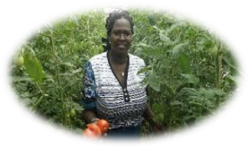



Agriculture Holds the Key to Unlocking New Growth Frontiers in Nigeria and Ensuring Prosperity for All
Large Internal Market
Expansive Unutilized Land
Abundant Water Resources
  167 million people
  Large labour force ~ 110 million youth expected in the workforce by 2020
  Low wages for agricultural intensification
  There are 84 Million hectares of arable land in Nigeria
  60% of the arable land is unutilized
  There is a potential irrigable area of 3.14 Million hectares, of which less than 1% is currently irrigated
  279 BN cubic meters of available surface water
  58 BN cubic meters of underground water
  3 of Africa’s 8 major river systems
Federal Ministry of Agriculture and Rural Development, Federal Republic of Nigeria
2
2

Slide 4


President Jonathan Launched a Time-Bound, Aggressive Plan to Unlock Nigeria’s Agricultural Potential
Agricultural Transformation Agenda (2011 – 2015)
Grow Food
Assure national food security by adding an additional 20 Million MT of food to the domestic food supply by 2015
Create Jobs
Over 3.5 Million jobs by 2015
Create Wealth
Agriculture as a Business and Not a Development Program
Implementing a Full Value-Chain Approach, From Farm to Table
Government-enabled, Private Sector-Driven Transformation

Slide 5


ICT IN THE AGRICULTURAL TRANSFORMATION AGENDA

Slide 6

We Ended 40 Years of Corruption in the Fertilizer Sector within 90 Days
Launch of the Growth Enhancement Support (GES) Scheme
Government direct procurement and distribution of fertilizers and seeds
Private sector companies now sell directly to farmers
Electronic vouchers (E-Wallets) developed to deliver subsidized inputs to farmers over their cellphones
Middle-men and rent seekers eliminated from the sector
  Nigeria is 1st country in Africa to develop the E-wallet for input delivery to farmers
GES has reached 6.4 million farmers
First ever national database of farmers developed
  - 10 million farmers registered
Notes:
5
5

Slide 7
The GES Initiative Has Ensured that Agricultural Inputs Has Reached More Farmers than Every Before
GES has experienced wide-spread participation from every state of the federation
Cross-section Sample % Of Farmers Who Received Their Subsidized Inputs Under GES in 2013, Compared to 11% Under the Old System
To be updated
11%
6
Notes:
6
6

Slide 8
The Federal Government Has Observed Continuous Improvements Since the Launch of the GES
93% Activity Rate
166% Increase
78% Increase
7
Notes:
7
7

Slide 9


We are Ensuring GES Is Sustained and More Accessible to Farmers across All of Nigeria
The GES TAP Is a World First
Enabling Nigerian farmers to access GES inputs using state of the art mobile technology
Connecting on line and off line farmers to their local agro-dealers… Even where there is not yet cellular network coverage
Allows for full weekly reconciliation reports…
And built in fraud prevention and detection

Slide 10
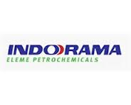


GES Implementation in the Fertilizer Sector, Combined with Petrochemical Gas Policy Have Accelerated Private Sector Investments in Domestic Fertilizer Manufacturing
$1.3 Billion Expansion Investment in Fertilizer Plant
$1.2 Billion Investment in Fertilizer Plant
$9 Billion Investment in Fertilizer & Petrochemical Plant
Federal Ministry of Agriculture and Rural Development, Federal Republic of Nigeria
9
9

Slide 11
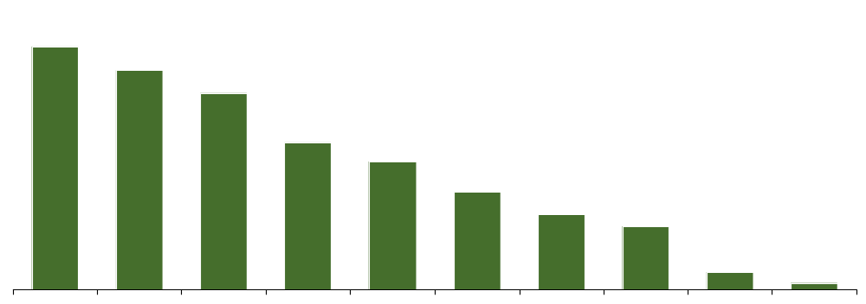










We are Turning Comparative Advantage into Competitive Advantage Through Food Processing for Import Substitution
Nigeria’s Top 10 Agricultural Products
000’s Tonnes, 2011
52,404
37,116
9,180
6,897
6,000
4,567
3,500
2,963
813
280
Cassava
Yams
Maize
Sorghum
Fresh Vegetables
Rice
Citrus fruits¹
Groundnuts
Cashew nuts
Indigenous Cattle Meat
Note: ¹Excludes Oranges, Lemons and Grapefruit
Source: FAO Stat; Index Mundi

Slide 12
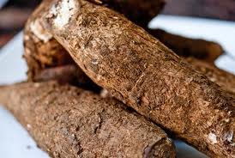




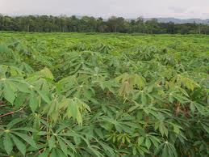

We Are Turning Nigeria Into the Largest Cassava Processor In the World
CASSAVA
Nigeria is the largest Cassava Growing Country in the World...
Raw cassava production
Mt, 2010
Nigeria
Brazil
Indonesia
Thailand
... But processes very little of its produce to value-added products
Cassava processed for industry¹
%, 2010
In the Cassava Value Chain Processing is Where Investors Can Capture the Greatest Value (Up to 57%)
Nigeria
Brazil
Indonesia
Thailand
11

Slide 13
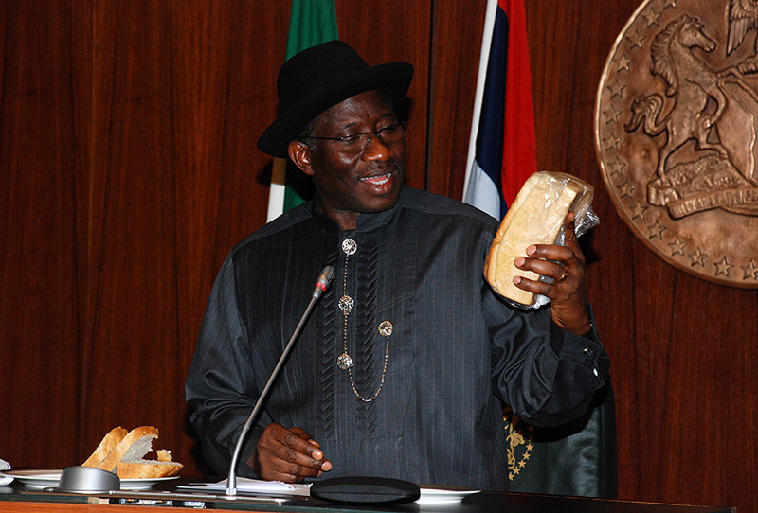
Mr. President launched 40% High Quality Cassava Flour (HQCF) Bread by IITA on 30 November, 2011 and challenged the private sector to commercialize
Federal Ministry of Agriculture and Rural Development, Federal Republic of Nigeria
12

Slide 14





Within Three Months, Cassava Bread with 20% Cassava Flour and 80% Wheat Became Commercially Available
Cassava Bread is approximately 30% cheaper than wheat bread and has a higher nutritional value
MASTER BAKERS
MASTER BAKERS
MASTER BAKERS
Feb 2012
Apr
2012
Aug
2012
Sep - Dec
2012
Jun
2013
August
2013
Federal Ministry of Agriculture and Rural Development, Federal Republic of Nigeria
13

Slide 15
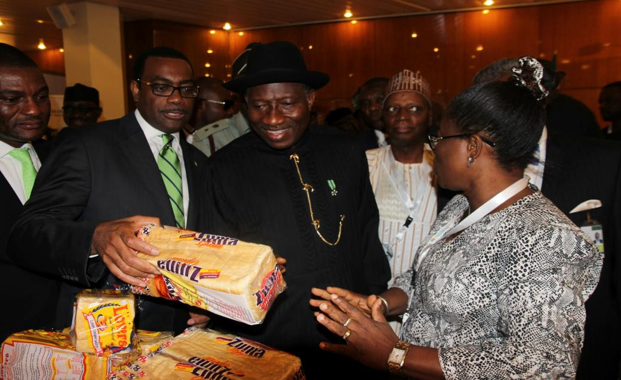
N10 Billion ($63 Million) Cassava Bread Fund is Fast-tracking the Smaller Master Bakers to Roll out Cassava Bread Brands Across the Country

Slide 16
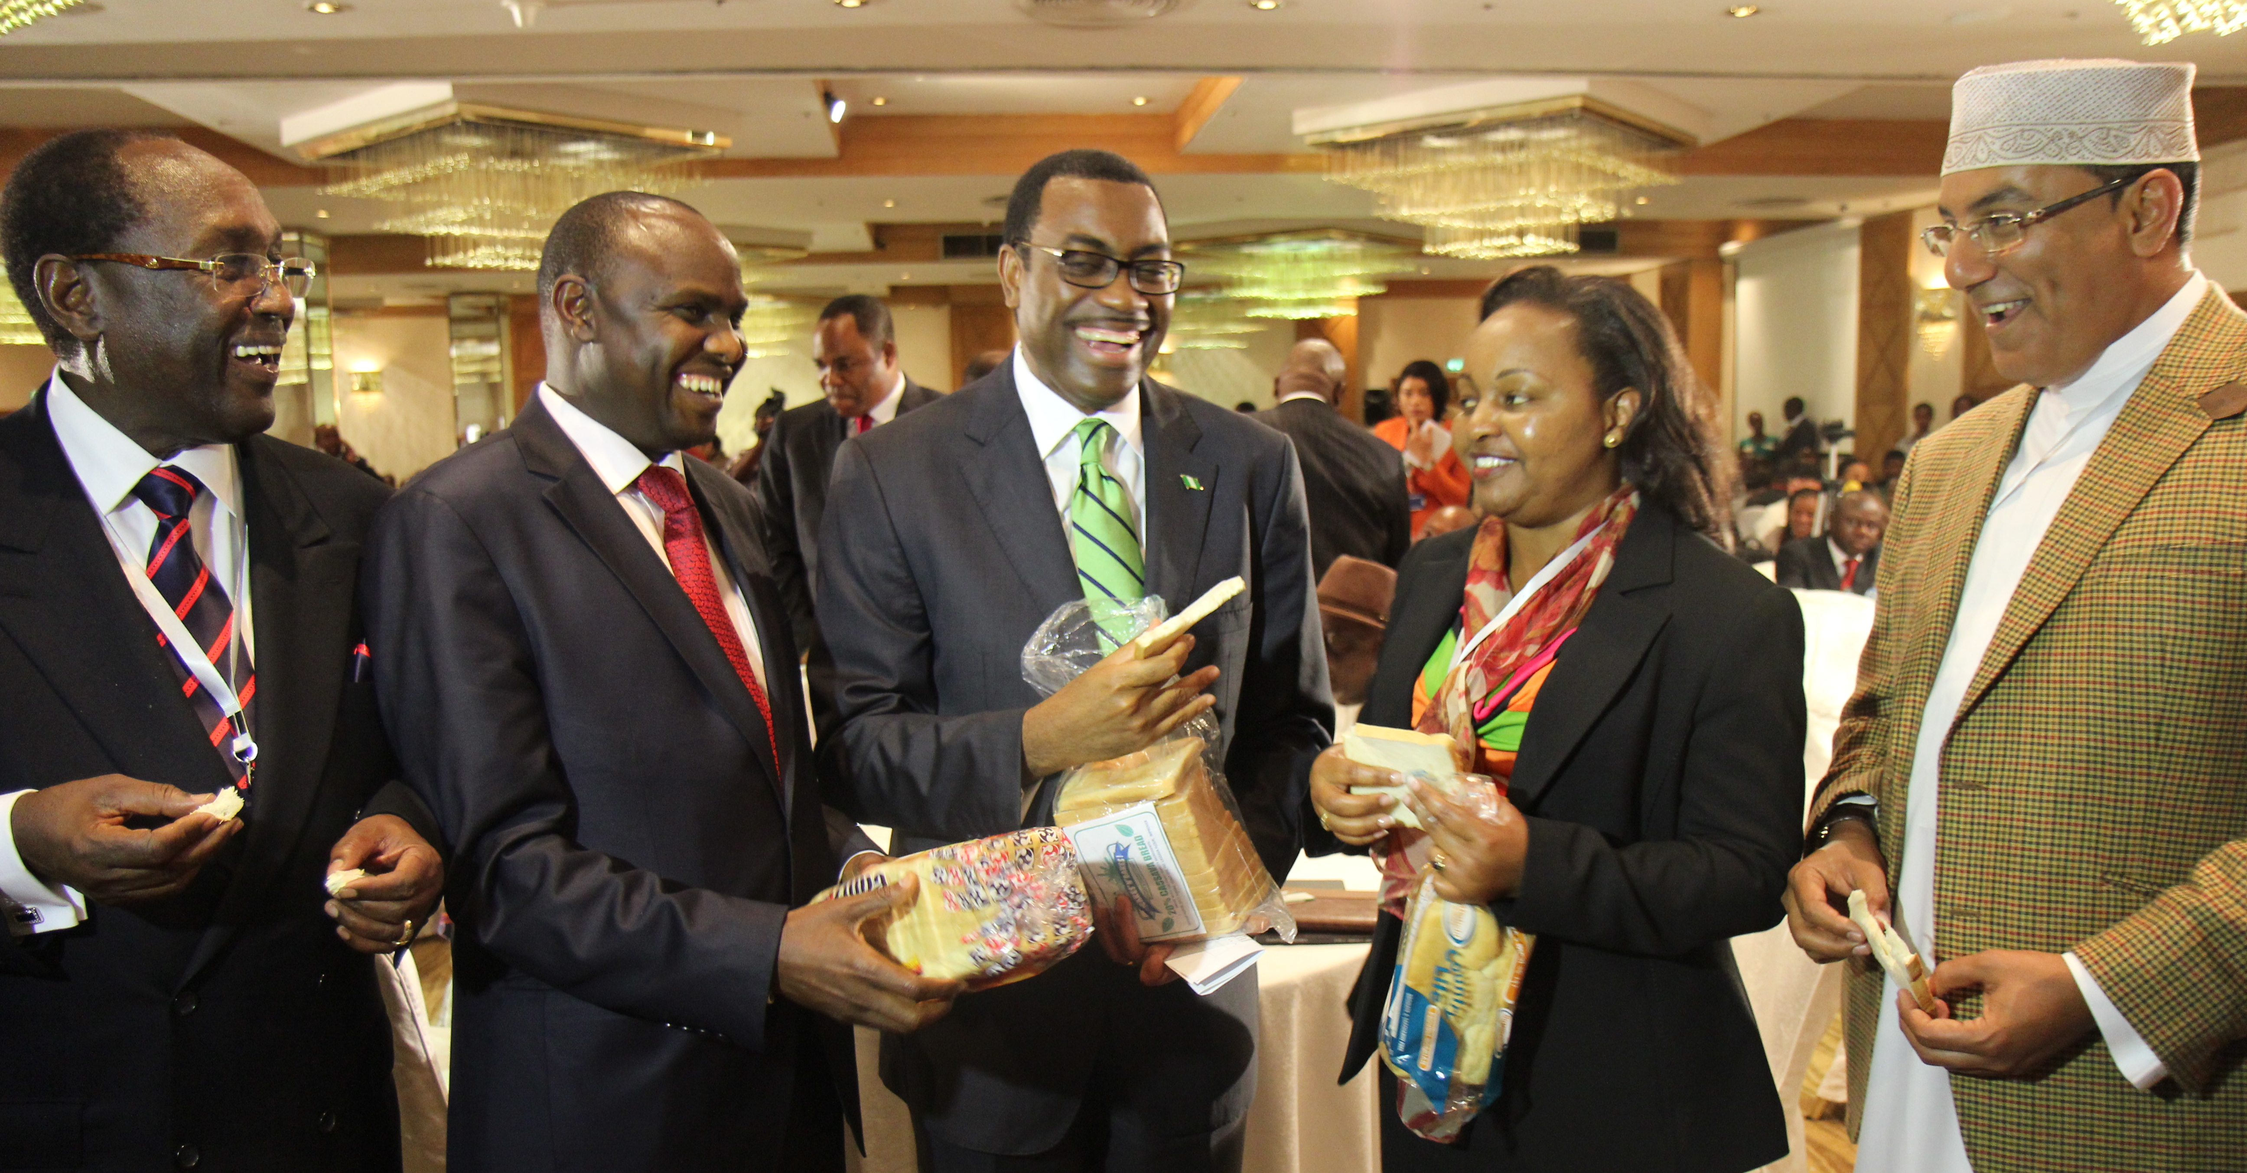
Cassava Bread Goes Continental
Private Sector and Cabinet Ministers in Kenya Enjoying Cassava Bread
Federal Ministry of Agriculture and Rural Development, Federal Republic of Nigeria
15
15

Slide 17








Leading Indigenous and Global Firms are Expanding Operations and Establishing New Cassava Processing Facilities in Nigeria
Cassava Starch, Sweetners, Sobitol, Beer and Ethanol

Slide 18
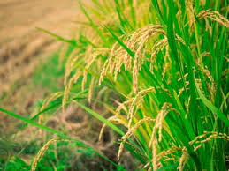
RICE
We are Unleashing a Rice Revolution to Become Self-Sufficient in Rice by 2015
Nigeria has set the goal to become self-sufficient in rice by 2015 and is making rapid progress on achieving the goal
Federal Government distributed 27,150 MT of improved rice seeds to rice farmers across the country;
In 2012/2013 (wet + dry seasons), Nigeria produced 1.86 Million MT of rice paddy. This represents about 40% of the total paddy needed to achieve domestic self-sufficiency
For 2013/2014 dry season, 2 Million MT additional Paddy, to produce 1.3 Million MT of milled rice, would produced; which will represent 43% of domestic rice requirement
Cumulatively, total rice produced is 83% of additional total domestic rice requirement if we are able to mill to an international grade standard.
Doreo

Slide 19
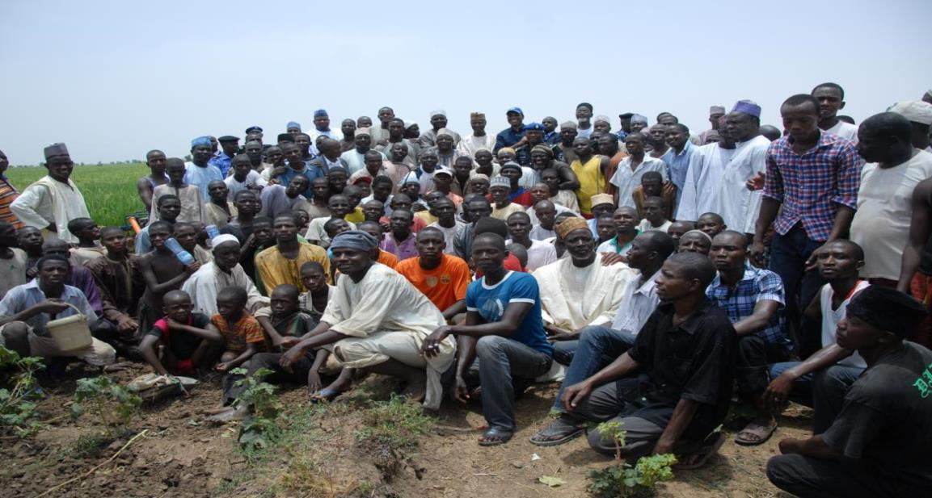
Dry Season Paddy Production Program Is Creating Employment for Youths in Northern Nigeria
Supported rice farmers with 164 7HP irrigation pumps, 3100 3HP irrigation pumps, 37 reapers and 74 thresher to enhance production
In January 2014, President Jonathan Announced 14 Billion Naira Dry Season Farm Support Program
Youths Out on the Rice Fields in the North During Dry Season Farming 2012/2013

Slide 20
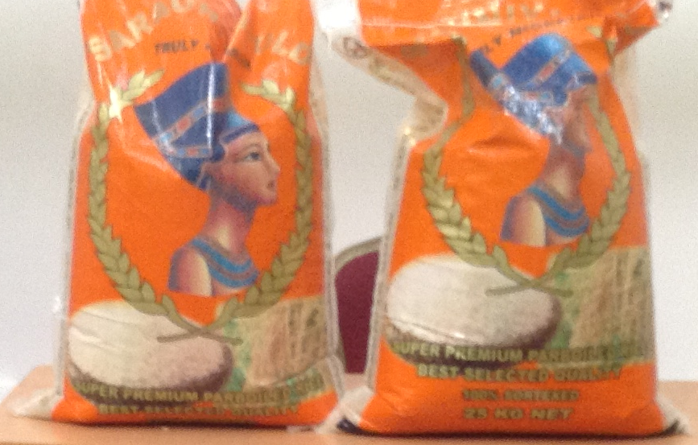
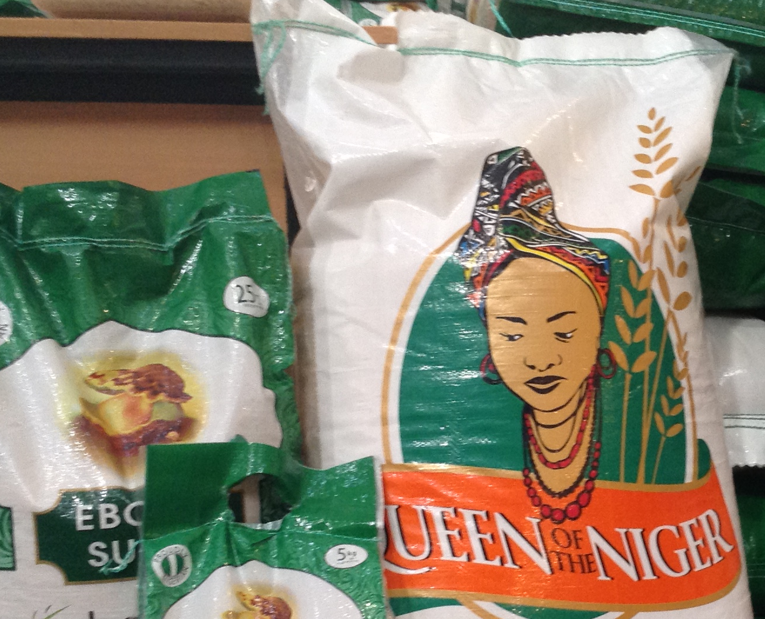

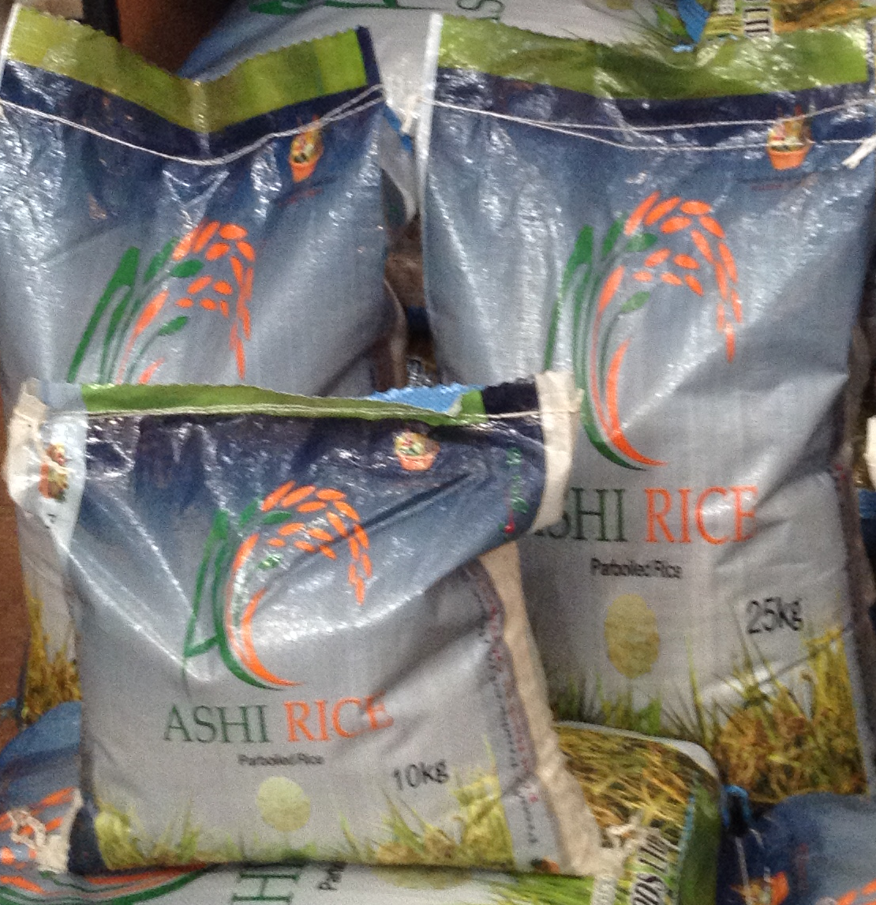
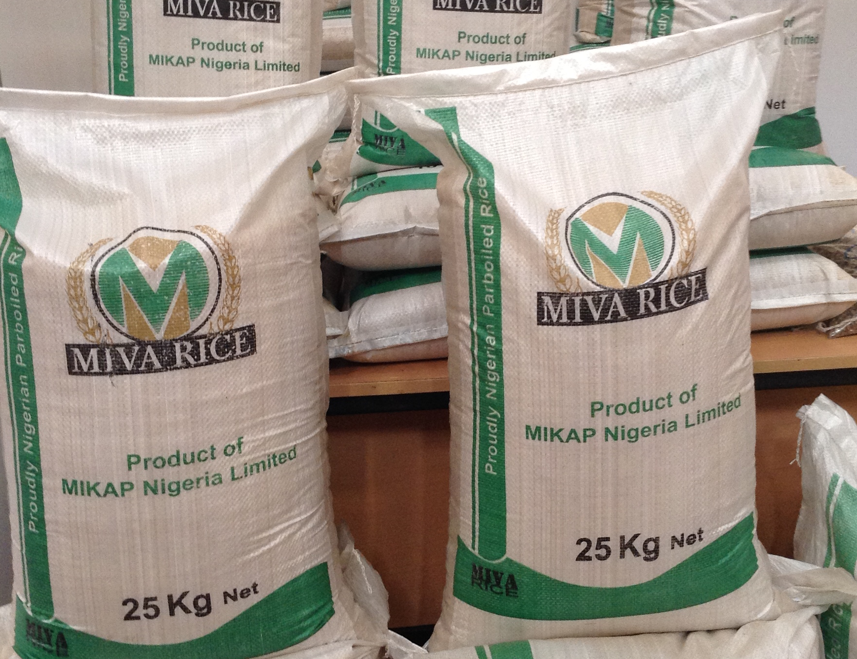

Private Sector Investors are Increasingly Expanding Integrated Processing of Local High Quality Rice
Rice milling capacity in Nigeria went up by 200% with 15 new private sector integrated rice mills milling 270,000 MT high Quality Nigerian parboiled rice
30,000 Ha Greenfield Integrated Rice Project in Nassarawa State
UMZA Rice Mills Kano
Ebony Agro Rice Mills
Dominion Farms investing $40 million in commercial rice production on 30,000 Ha in Taraba State
Ashi Rice Mills
Mikap Rice Mills
New Rice Tariff Policy Will Promote Increased Local Production
and Processing of Paddy

Slide 21
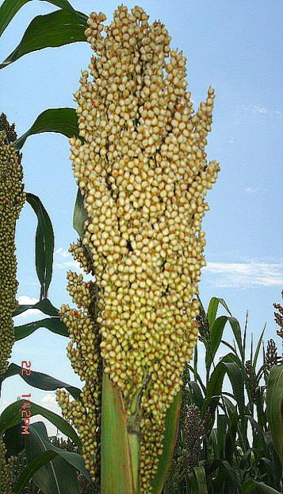

SORGHUM
We are Unleashing New Economic Opportunities for Sorghum Farmers Across Northern Nigeria
  New High Yielding Sorghum Hybrids Released by Nigerian Scientists
  Goal is to produce 4 million MT of sorghum from the new hybrids for malt and food manufacturing
  Two sorghum hybrids were released, with yield of 3.5-4 MT per ha compared to the normal yield of 0.5-0.8 MT per ha
  In 2013, distributed 500MT of Certified High yielding Sorghum seeds to 100,000 farmers and each collected 5kg of seed free and two bags of fertilizer at 50% subsidy;
  Collaborated with the International Crop Research Institute for the Semi-Arid Tropics (ICRISAT) which boosted production, utilization and commercialization of Sorghum
  Initiated a ‘Partners for Sorghum Transformation’ with Nigerian Breweries Ltd. in 2013 which trained Seed Companies and NBL seed out-growers
Doreo

Slide 22
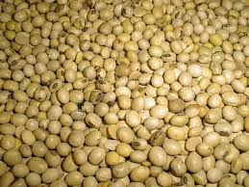
SOYBEANS
Soyabeans
  Distributed 2,399MT Certified Seeds, 80,000 bags of fertilizers and 80,000 litres of agro-chemicals as well as 400,000 fungicides to farmers in 20 States through GES;
  Goal is to produce 1 million MT of soybean by 2015 for use for food, feed, and industrial purposes
  Multiplied 70MT Foundation Seeds and 5MT Breeder Seeds from the National Crops Research Institute (NCRI), Badeggi
  Established Seed field that was planted on the production of 5 MT BS and 70 MT FS
  Procured 40 Soybean multi-purpose Threshing Machines;
Doreo

Slide 23

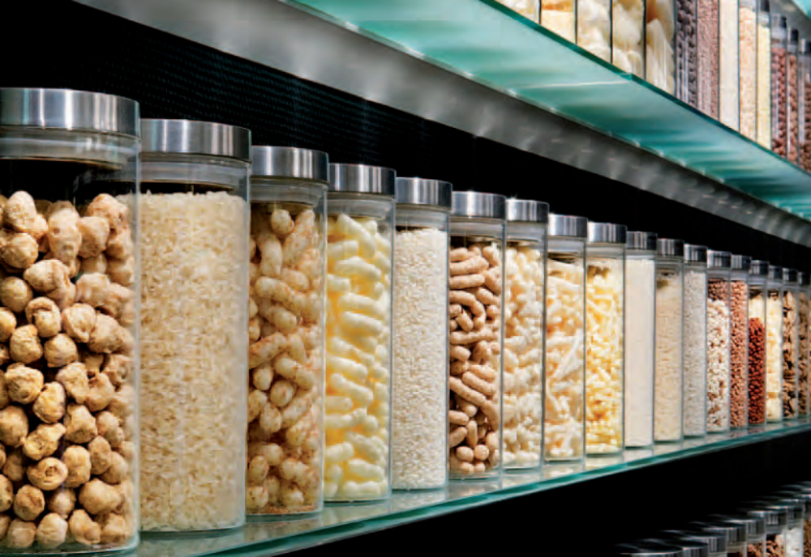


New Public-Private Partnerships to Make Nigeria the Largest Processor of High Energy Foods in the World
Using Domestically produced Sorghum, Soybeans and Maize
Dansa Foods of the Dangote Group is investing EUR 36 million to establish the largest high-energy foods plant in Africa using sorghum, maize and soybeans for fortified foods and cereals, particularly for weaning children
Strategic partnerships being developed for with the World Food Program to purchase high energy foods from Nigeria
Federal Ministry of Agriculture and Rural Development, Federal Republic of Nigeria
Federal Ministry of Agriculture and Rural Development, Federal Republic of Nigeria
22
22
22
22

Slide 24
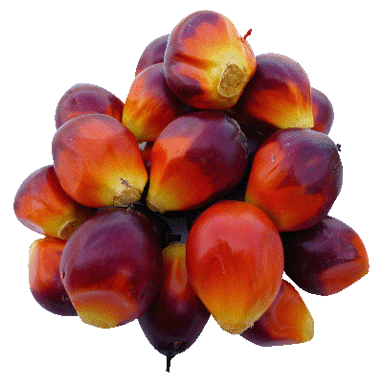
OIL PALM
We are Unleashing New Economic Opportunities for Oil Palm Across Northern Nigeria
Doreo

Slide 25


Private Sector Oil Palm Investors Are Rapidly Expanding
Integrated Operations in Plantations and Refineries
Federal Government Is Providing 9 million Sprouted Seedlings to Farmers and Private Plantations Free of Charge
  Okomo oil expanding cultivation by 9,000 ha and new processing facilities in Edo state
  Presco Plc has plantations of 11,760 ha with processing facilities including a palm oil mill, refinery and palm kernel crushing plant in Edo and Delta States
IDG
  $250 million investment by IDG commencing in 2013 in Edo and Ogun State
Federal Ministry of Agriculture and Rural Development, Federal Republic of Nigeria
24
24

Slide 26
Oil Palm Investments Offer High Returns on Nigeria’s Stock Exchange
  Sample Operating, Valuation, and Returns Metrics
Industry | Company | Revenue Growth | Stock Price Appreciation | P/E | Dividend Yield
 |  | 2012-2013E | 2011-2012 | 2013 | 2012
Consumer Goods | Guinness Nigeria PLC | 0% | 10% | 31.5x | 3.1%
 | Nigerian Breweries PLC | 9% | 56% | 28.7x | 1.8%
 | Nestle Nigeria PLC | 18% | 57% | 31.2x | 2.0%
 | UAC of Nigeria PLC | 23% | 35% | 23.3x | 2.1%
Financial Institutions | Guaranty Trust Bank PLC | 11% | 61% | 8.1x | 5.9%
 | United Bank for Africa PLC | 15% | 80% | 4.9x | 6.0%
 | Zenith Bank PLC | 10% | 60% | 6.7x | 7.5%
Agriculture | Okomu Oil Palm Co. PLC | 8% | 84% | 11.2x | 7.6%
 | Presco PLC | 15% | 96% | 23.6x | 2.5%
Source: Broker Reports, FMARD analysis
Federal Ministry of Agriculture and Rural Development, Federal Republic of Nigeria
25
25

Slide 27
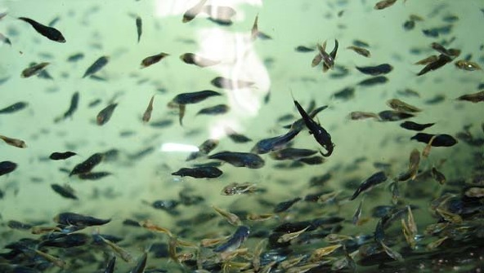
FISHERIES
We are Aggressively Revamping the Fisheries Sector to Reduce Imports
Doreo
  2,909,000 juveniles were redeemed by 5,819 fish farmers in ten States.
  Beneficiary farmers also received 436.8MT of fish feed at 50% subsidy.

Slide 28
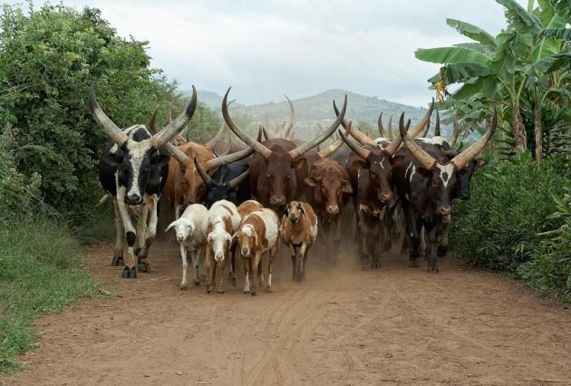
LIVESTOCK
We are Unleashing New Economic Opportunities for Oil Palm Across Northern Nigeria
Doreo

Slide 29

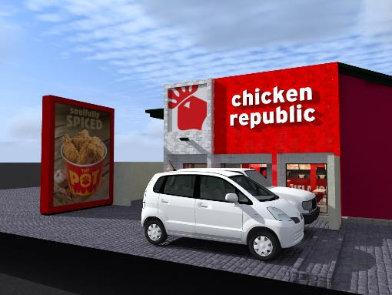
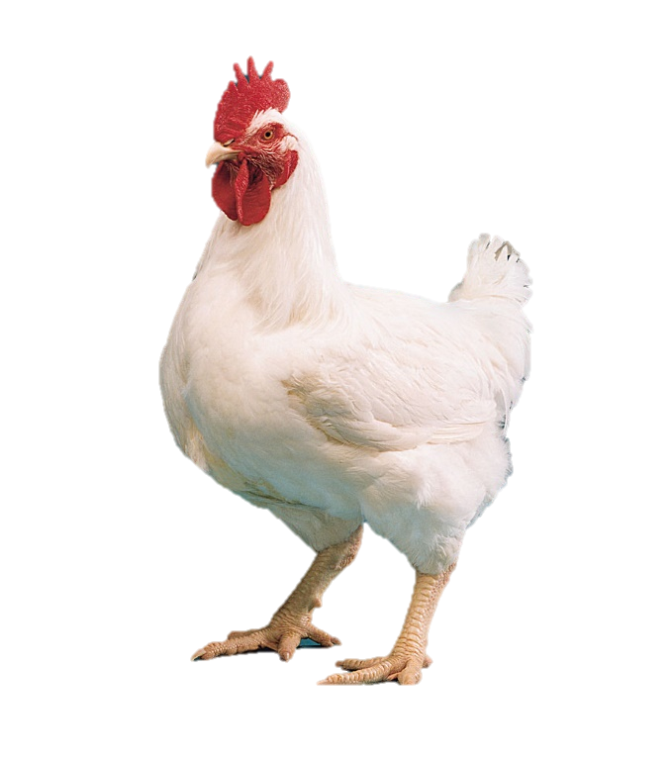

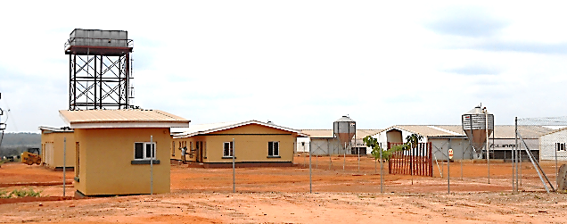
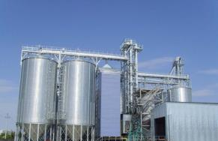
Poultry Production
Food Concepts Invest $55 Million In Integrated Poultry Facility
The Farm
$27 Million investment
700 Ha of farm land in various parts of South West region of Nigeria
Broiler Farm
Expected to produce over 600,000 broilers monthly
Processing Plant
Expected to process 1 million birds/ month
Out-grower scheme is expected to yield 600,000 birds/month
Feed Mill
Expected to mill 8,000 MT / month of feed

Slide 30

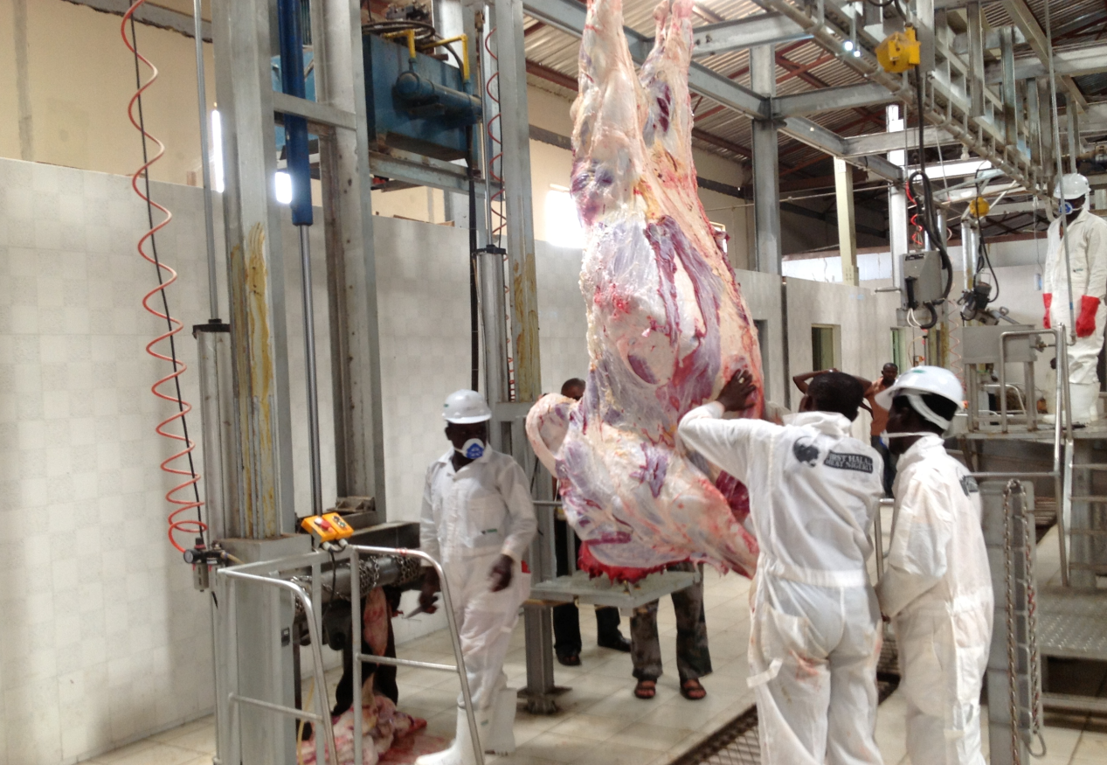
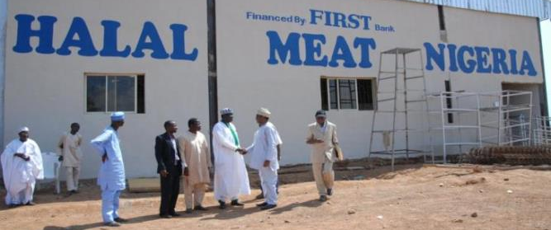
Beef
Halal Certified Beef Private Investment by Famag-Jal Farms will Transform the Beef Industry
$6.3 million investment in Halal Certified processing plan
State-of-the-Art Abattoir facility launched in September 2013 with capacity / day for:
  300 Cows
  890 Sheep
  1870 Goats

Slide 31
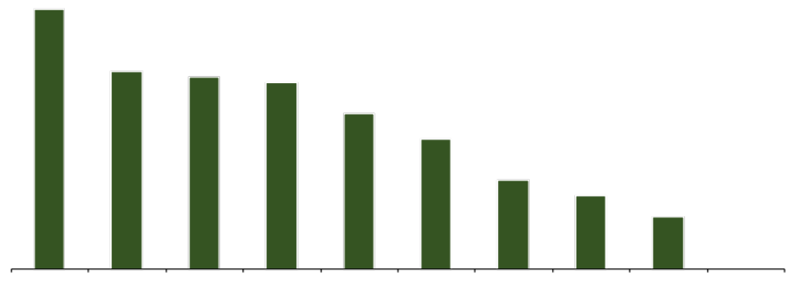
We are Acutely Aware of the Challenges Facing Private Sector Agribusiness Investors
Infrastructure, Financing and Supply Security are the Most Common Challenges Cited by Private Sector
AGRO-PROCESSING CLUSTERS
% of the 75 Respondents Citing Challenges, by Category¹
Infrastructure was consistently cited as the greatest barrier to investment, regardless of investor type, size, location, or stage of value chain
72%
56%
55%
53%
45%
39%
28%
24%
19%
5%
Infrastructure
Financing
Securing Supplies
Policy & Regulatory Environment
Human Capital
Governance
Information & Communication
Land
Government Coordination
Competitive Environment
Note: Data from 75 investors; ¹Respondents have cited all challenges that are applicable to them
30

Slide 32
Staple Crop Processing Zones (SCPZs) are Being Established
To Serve as Integrated Infrastructure Platforms to Accelerate Private Sector Investments in Large Scale Agro-Processing
1
Reduce food imports: By increasing farm productivity and enhancing domestic processing for the growing consumption market
Increase agriculture value-addition through processing: By being a catalyst to foster innovation and to evolve new products, processes, technologies for sustainable agribusiness development
Reduce post-harvest losses: By promoting synergies and productive relationships between farmers and business enterprises on an inclusive growth model
Reduce the cost of doing business for agro-processors: By providing global competitive industrial, environmental, social infrastructure that attract companies and best talents in the field of agribusiness.
Create wealth and jobs and drive rapid rural growth: To lift farmers out of poverty through an agricultural sector that drives income growth, accelerates achievement of food and nutritional security, generates employment and transforms Nigeria into a leading player in global food markets to grow wealth for millions of farmers.
2
3
4
5
Federal Ministry of Agriculture and Rural Development, Federal Republic of Nigeria
31
31

Slide 33
13 SCPZ Sites Have Been Identified Across All Regions of Nigeria
Masterplans have been produced for the development of 6 sites
Selected SCPZ sites and anchor crops
SCPZ sites
SCPZ sites with Masterplans
Rice
Horticulture
Badegi (Niger)
Bunkure-Kadawa (Kano)
Adani / Omor (Enugu, Anambra)
Gassol (Taraba)
Ambrusa / Binji (Kebbi, Sokoto)
Sokoto
Katsina
Bunkure-Kadawa (Kano)
Makurdi (Benue)
Oban (Cross River)
Jigawa
Yobe
Kebbi
Zamfara
Kano
Borno
Kaduna
Bauchi
Niger
Gombe
Adamawa
Cassava
Plateau
Kwara
Fct
Alape (Kogi)
Ososa (Ogun)
Oyo
Nassarawa
Osun
Ekiti
Kogi
Taraba
Ogun
Ondo
Benue
Edo
Enugu
Cross
River
Sorghum
Lagos
Anambra
Ebonyi
Fisheries
Bunkure-Kadawa (Kano)
Biu (Borno)
Delta
Imo
Abia
Ketu-Ereyun (Lagos)
Okorolo (Rivers)
Ebedebiri (Bayelsa)
Bayelsa
Rivers
Akwa
Ibom
32

Slide 34
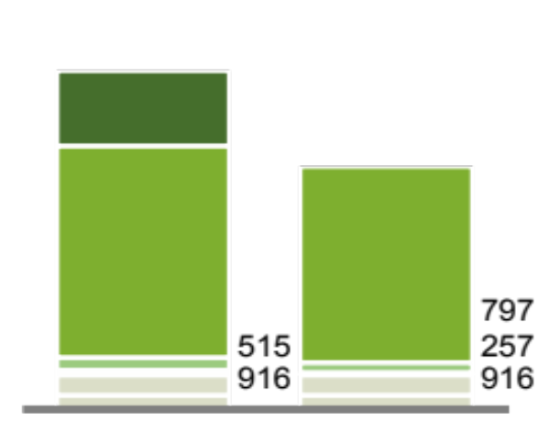
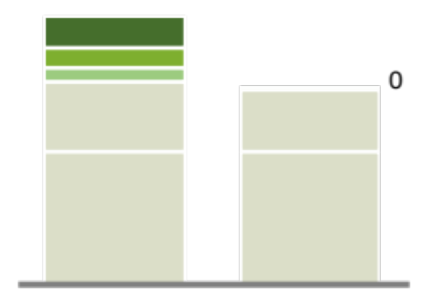
SCPZs Will Provide Investors with a Significant Cost Competitive Advantage of ~27% Compared to Other Non-SCPZ Investors
Alape, Kogi SCPZ Cassava Case:
Cost structure of 75,000Mt starch factory with a 6,000 Ha nucleus farm
USD$ thousands, Year 5 (ramp up completed)
Taxes
1.016
680
-25,9%
-28,0%
Land clearing costs¹
450
Taxes
6.140
Financing costs²
308
87
0
0
Labour costs
1.556
1.387
Raw materials
Transportation costs
16.934
15.938
Financing costs
Other costs³
2.869
2.869
Labour costs
Other costs³
1.664
1.664
Other non-SCPZ location
Alape SCPZ
Other non-SCPZ location
Alape SCPZ
Nucleus farm
Starch factory
Federal Ministry of Agriculture and Rural Development, Federal Republic of Nigeria
33
Notes:
DFI Gaurantee’s
Agriculture is growning and we are diversifying the economy
Government is investing heavily
We are strongly supporting a private sector initiative to grow the agriculture movement
We become better performing stocks
Growing population growth
Import Substitution
Incentives to companies to do value addition and processing focus sharply on value chain development Not just production becos of the increased investment we are witnessing now in the agricultural sector due to the policies of government
Cite the Nation July 11th 2012
New Fiscal Measures Boost Agric Stocks
Market analyst have said that the new agric centric fiscal policies measures will impact positively on quoted agric companies and enhance their profitability within the medium to long term. The new policy measures were the much needed incentives to boost large scale agricultural business… the new measures will be general impetus for the sector. Nation Wed July 11 2012 pg 47. Nation Investors

Slide 35
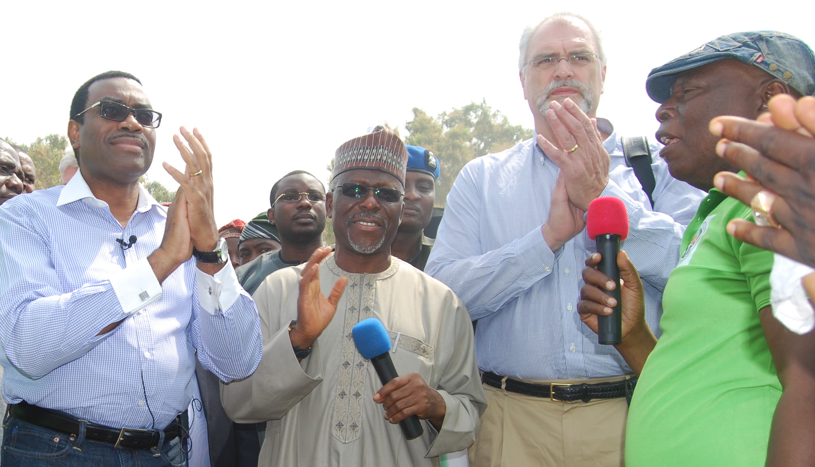
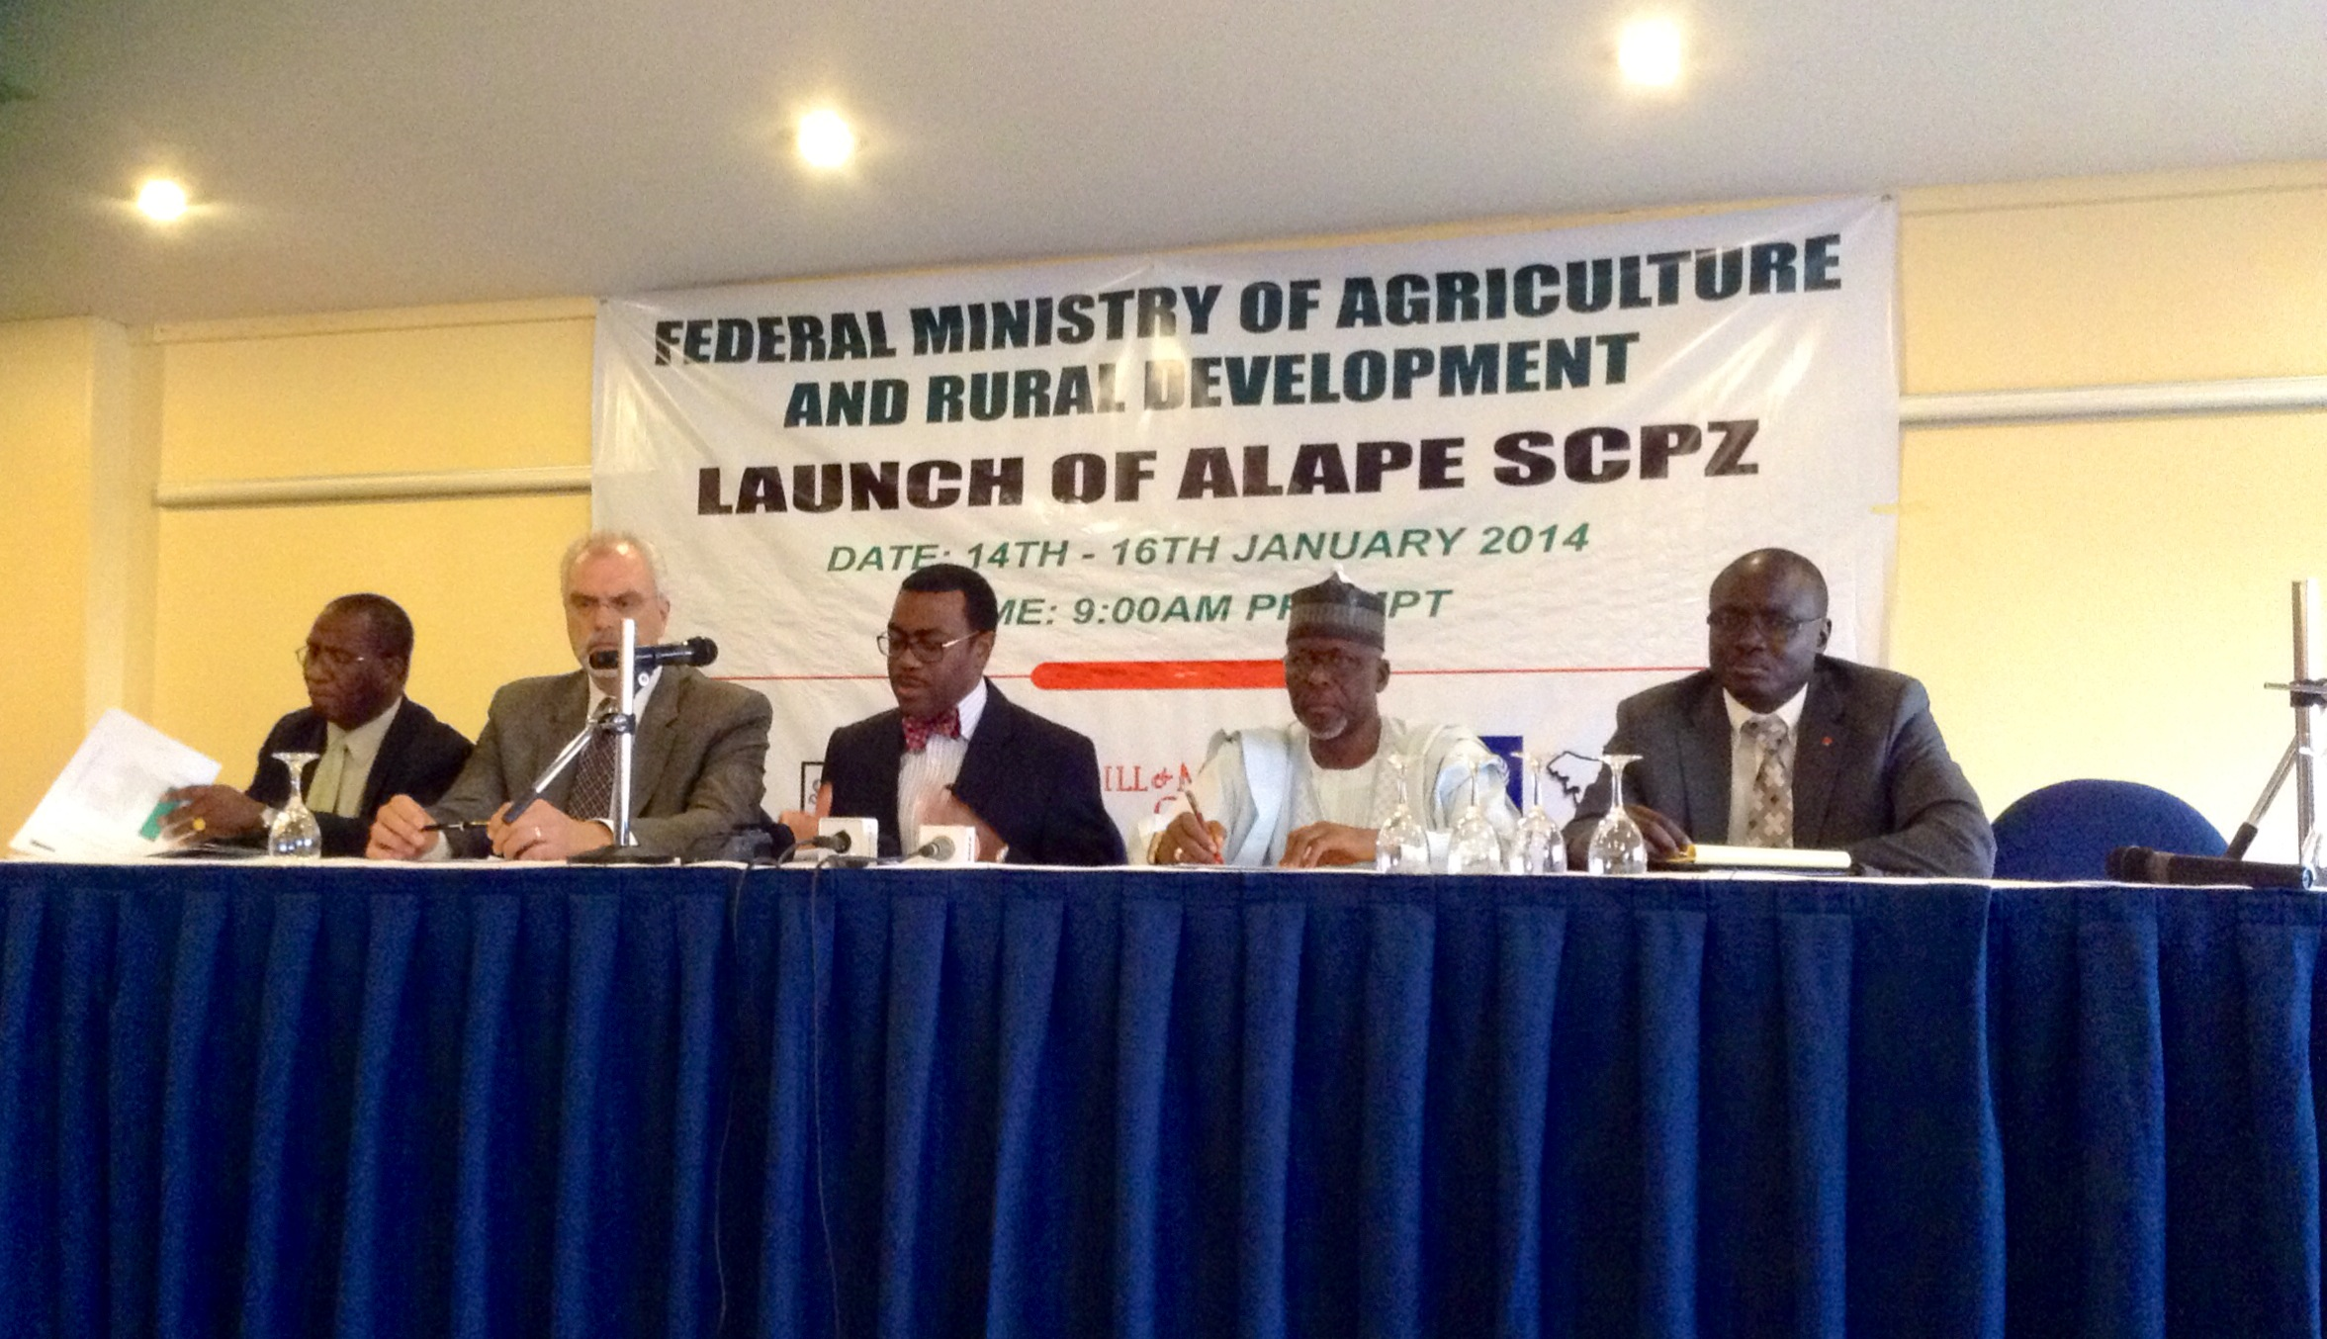
Cargill Inc., the World’s Leading Agribusiness Company, Is the Anchor Investor in Alape SCPZ
Cargill Senior Executives Kicked-Off Stakeholder Roadshow in Jan 2014
$100 Million Investment
In Cassava Farming and Processing Project

Slide 36




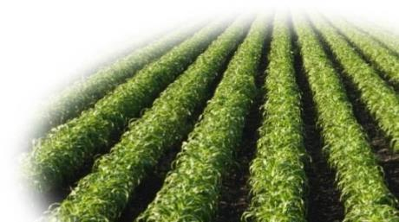
SCPZs Will Contribute Immensely to Nigeria’s Economy
The Initial 13 SCPZ Sites are Expected to Contribute Over 592 Billion – 1.5 Trillion Naira to the Nigerian Economy and Create Up To 250,000 Direct Farm Jobs
Direct impact
1,800-2,750
700-1,050
550-830
160-245
140-210
Acreage
Total yearly farming production
Total yearly processing production
Gross contribution to GDP
Jobs
Thousands Ha
Thousands Mt
Thousands Mt
Million US$
Thousands
Indirect impact
  Education and training opportunities (Capability building)
  Technology transfer
  Improved community infrastructure
  Indirect economic growth (e.g. services to the zone’s employees)
SOURCE: FMARD; Team analysis
Federal Ministry of Agriculture and Rural Development, Federal Republic of Nigeria
35
35

Slide 37
FINANCING
NIRSAL Plc. Helped Leverage 60 billion Naira for Farmers from Commercial Banks in 2013
  The Banking Sector increased its financing of GES from N3.5 billion worth of loans in 2012 to over N20 billion in 2013.
  Payments claims settled so far in 2013 for wet season is N36.00 billion.

Slide 38
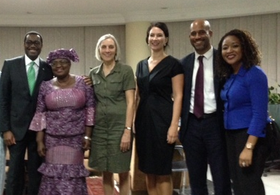



Financing Agricultural SMEs
Nigeria and Germany Launch Agribusiness Private Equity Fund
- The Fund for Agricultural Financing in Nigeria (FAFIN)
Funding: Capitalized initially with $33million by the Federal Government, KfW and Nigerian Sovereign Investment Authority. Scaled to up to $100 million by private sector
Management: Sahel Capital, an independent, private-sector fund manager
Target investees: Primarily SMEs
Investment Size: $500,000 - $5 mn
Instruments: Long-term, tailored financing, as well as quasi-equity, and other innovative financing instruments
Technical Assistance Facility: 10% of the total Fund size
First Close: January 2013

Slide 39
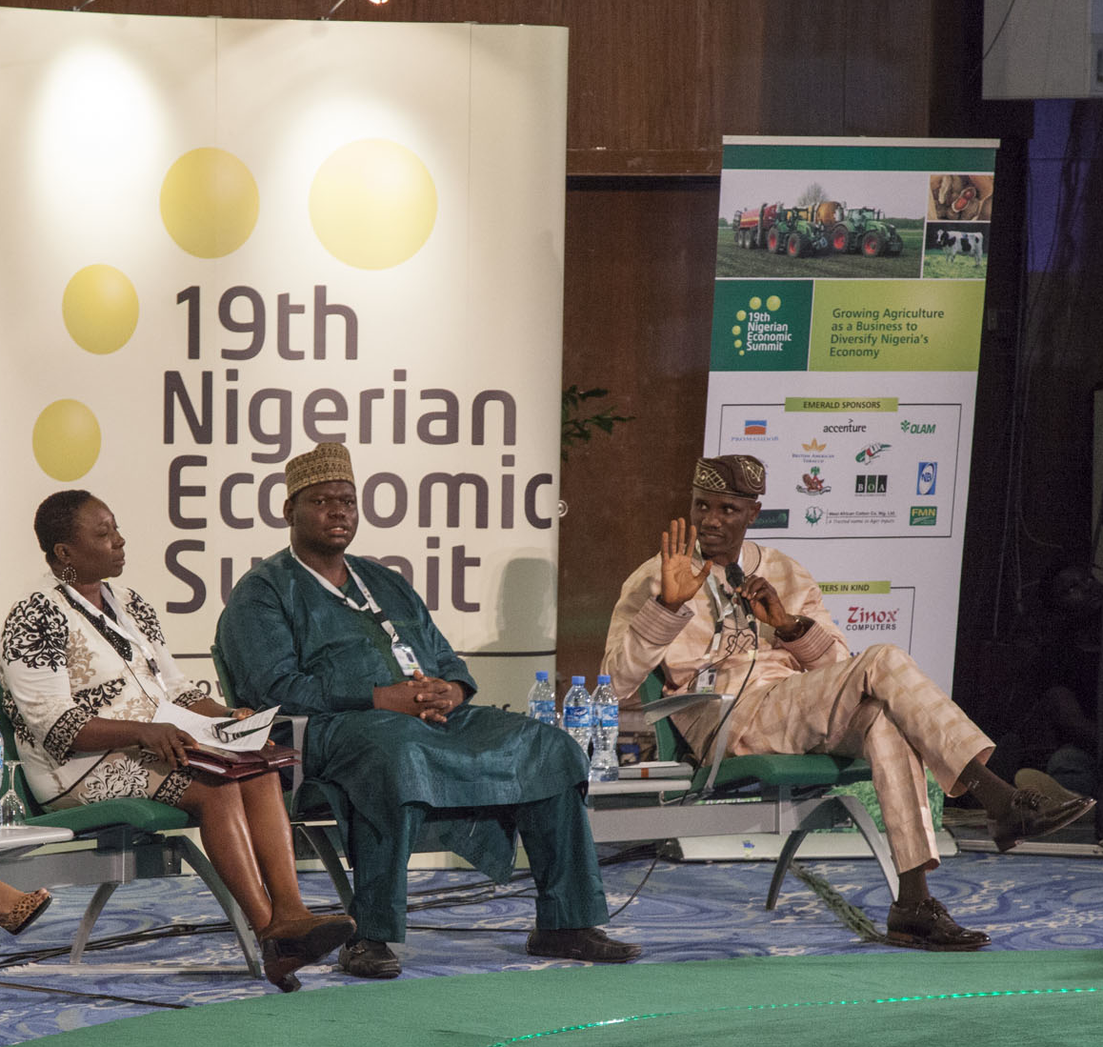
Youths and Women
A New Generation of Commercial Farmers and Agribusiness Entrepreneurs Emerge in Nigeria
    In 2013, a total 5,325 women and youths comprising of 3,051 women and 2,274 youths were trained and financed in 20 agricultural enterprises along 10 value chains,
    We are changing the labor composition of the agricultural sector with a new generation of young commercial farmers and agribusiness entrepreneurs - Nagropreneurs
    Goal is to develop 760,000 Nagropreneurs over 5 years who will create 7 million direct and indirect jobs in the agriculture sector
    Reverse rural-urban migration and address national insecurity issues
    The Nagropreneurs will change the mindset and the face of agriculture in Nigeria
38
Federal Ministry of Agriculture and Rural Development, Federal Republic of Nigeria
38
38
Notes:
n the last ten years, approximately 20 million youth entered the country’s labor market and only a small fraction was able to secure employment.

Slide 40
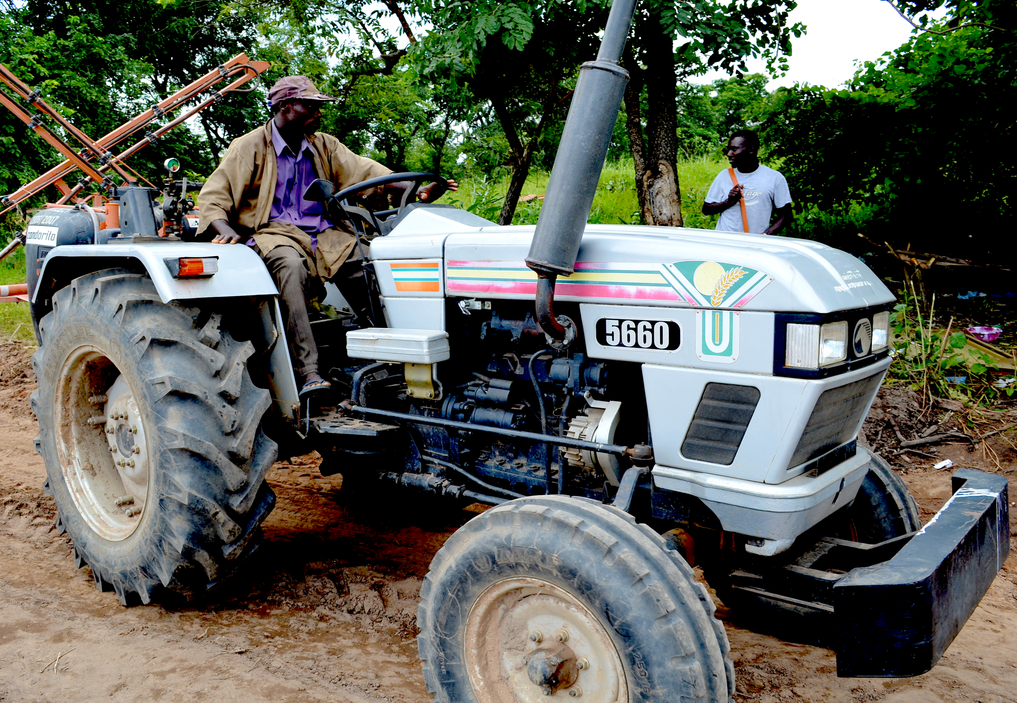
IMPACT OF THE AGRICULTURAL TRANSFORMATION AGENDA

Slide 41
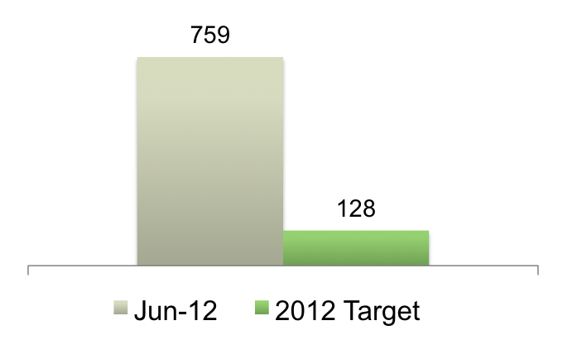
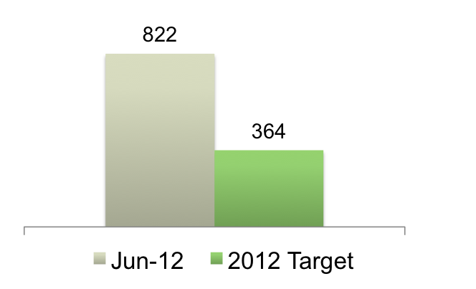
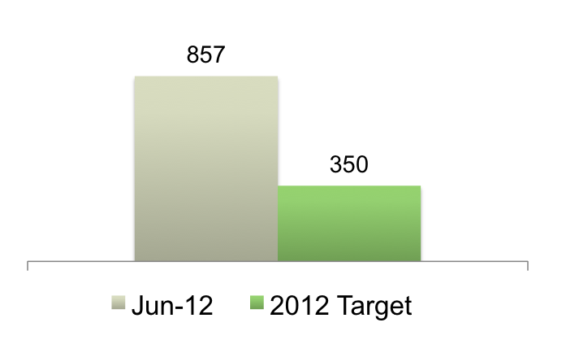
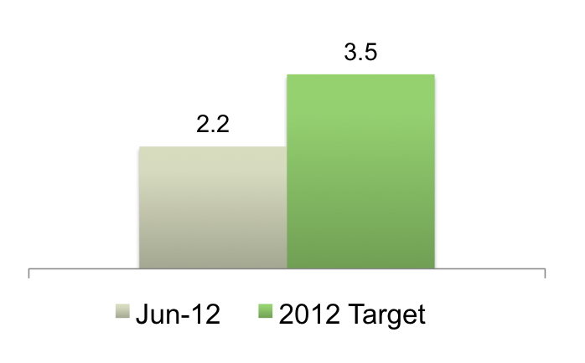
Since its Launch, the Agricultural Transformation Agenda Has Recorded Achievements that Have Impacted the Nigerian Economy
Increase in Agricultural Earnings
Increase Agricultural Exports
Naira, Billions
000’s MT
493% Above Target
144% Above Target
Dec- 12
Dec- 12
Reduction in Agricultural Imports
Job Creation
Naira, Billions
Millions
63% of Target
144% Above Target
Dec- 12
Dec- 12
2015 Target
40

Slide 42
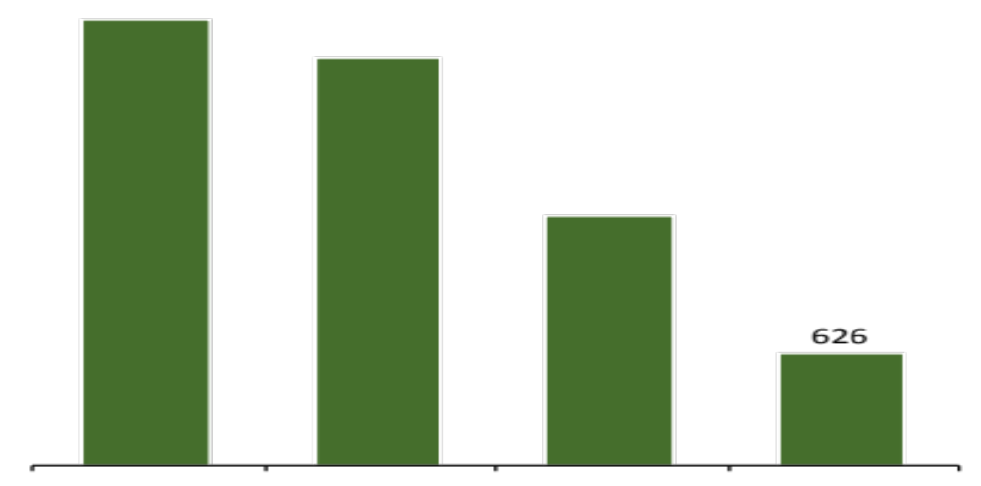

    Nigeria’s Import Bill of Wheat, Rice, Sugar and Fish Declined From $11billion in 2011 to US$8 billion in 2012
    Similar downward trend expected to have occurred in 2013
Nigeria’s Top Agricultural Imports
USD MN¹, 2012
4,097
2,297
1,400
Wheat
Rice
Sugar
Fish
Note: ¹Converted to USD at a rate of 1 USD: 155 Naira
Source: Central Bank of Nigeria; FAO Stat; “Strong Merchandise Growth in 2012”, National Bureau of statistics, 2013
41
Federal Ministry of Agriculture and Rural Development, Federal Republic of Nigeria
41
41
41

Slide 43
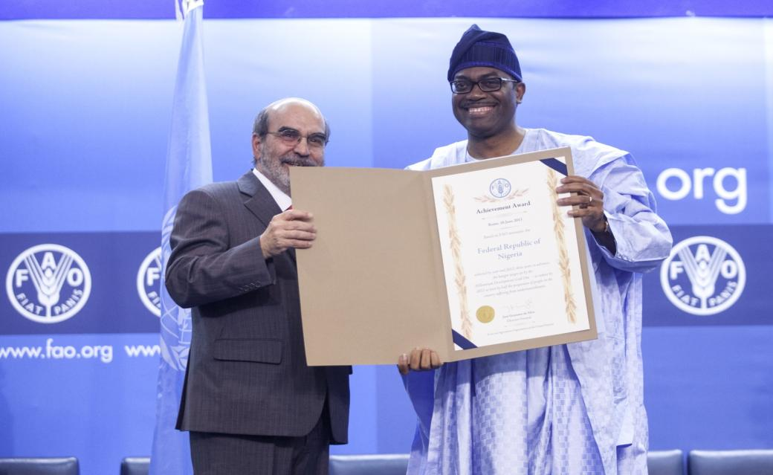
Nigeria Achieved MDG 1 Target on Hunger by 2012, Three Years Ahead of 2015 Target
FAO Recognizes Nigeria with Achievement Award – 16th June 2013, Rome

Slide 44






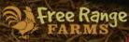

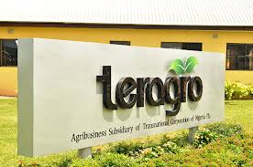




The Agricultural Transformation Agenda Has Attracted Over $4 Billion of Private Sector Investments Across all Major Value Chains
30 Executed Letters of Intent (LOIs)
  Local and international operational and financial investors have committed to investing across all stages of the agricultural supply chain
UMZA INTERNATIONAL FARMS
Federal Ministry of Agriculture and Rural Development, Federal Republic of Nigeria
43
43

Slide 45





Global Leaders Are Supporting Nigeria’s Agricultural Transformation
Presidential Eminent Persons Group (EPG) on Nigeria’s Agriculture
Meetings Held in January 2013 and September 2013
KOFI A. ANNAN
Chairman of the Board of AGRA; Secretary General of the United Nations (1997-2006); Nobel Peace Prize Laureate
BILL GATES
Co-Chair and Trustee, Bill and Melinda Gates Foundation; Chairman, Microsoft
DONALD KABERUKA
KANAYO F. NWANZE
President, African Development Bank
President, International Fund for Agricultural Development (IFAD)

Slide 46
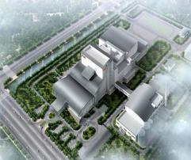
We are Institutionalizing ATA Policies and Involving Private Sector to Ensure Sustainability of the ATA’s Impact in Future Years
Growth
Enhancement
Scheme
(GES)
    Legalizing the GES though a ‘GES LAW’ to ensure Nigerian farmers and agribusinesses have sustained access to critical agricultural inputs
    GES Bill has been drafted
    State governments and anchor investors have committed, to ensure lasting implementation of value-added agro-processing through broad-based private-sector engagement
    SCPZ Policy and Bill have been drafted
SCPZ
Nigeria
Agribusiness
Group
(NABG)
    Private Sector industry body launched in 2013 to drive agribusiness sector developments and lead public-private engagements
    Will hold subsequent governments accountable for effective policy-making
STATE AGRICULTURAL TRANSFORMATION AGENDA (SATA)
    Entrenching the Agricultural Transformation Agenda at the State-level
    Implementation underway in Kogi and Benue states

Slide 47
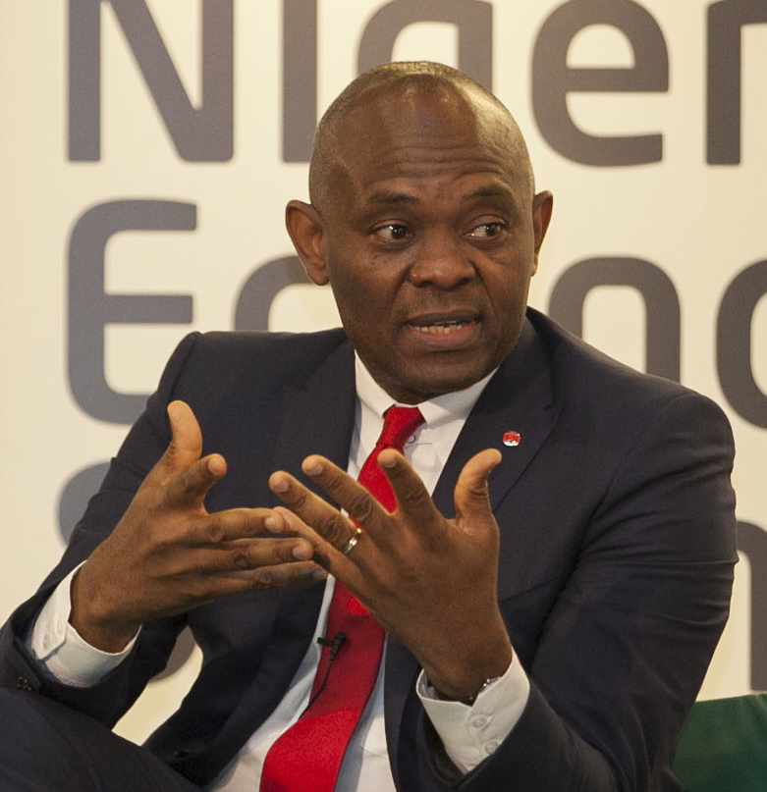


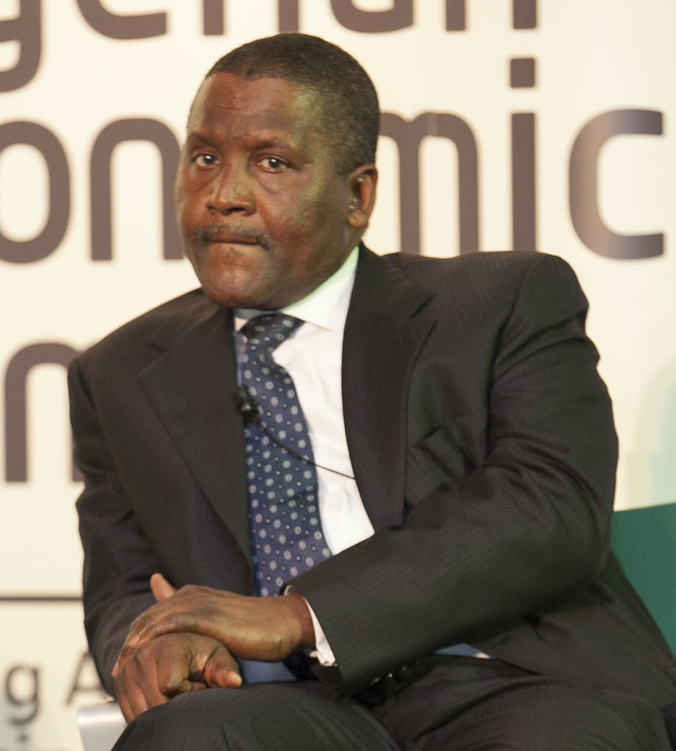
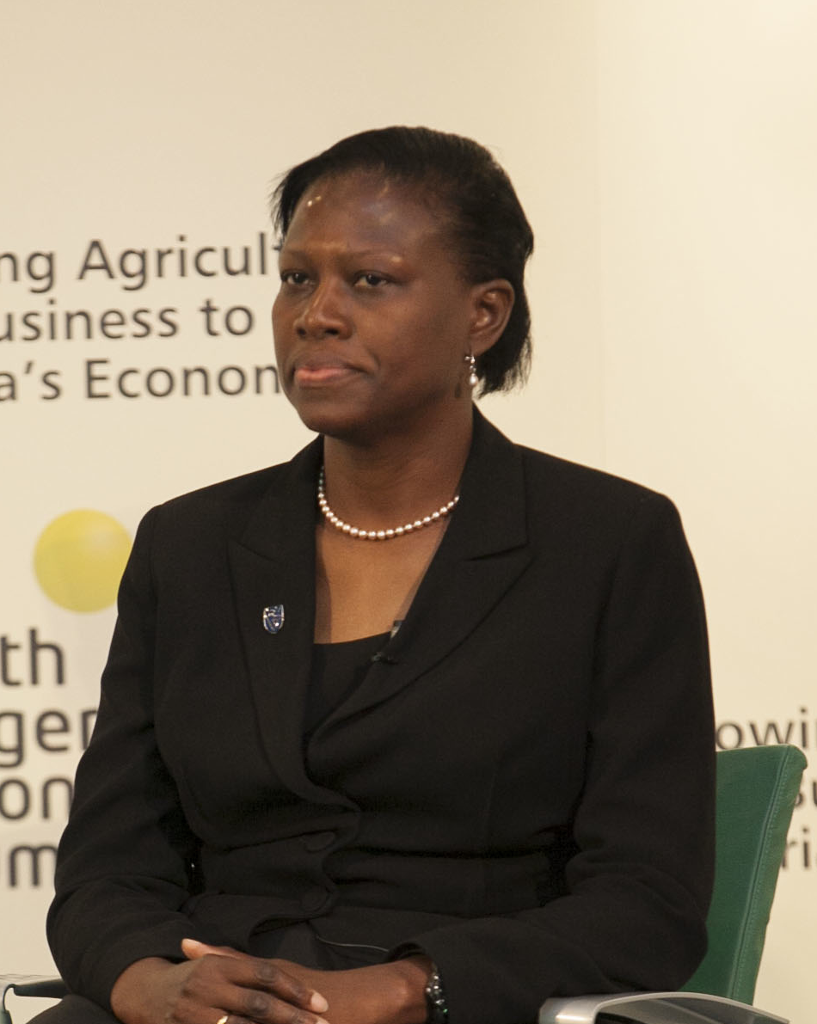
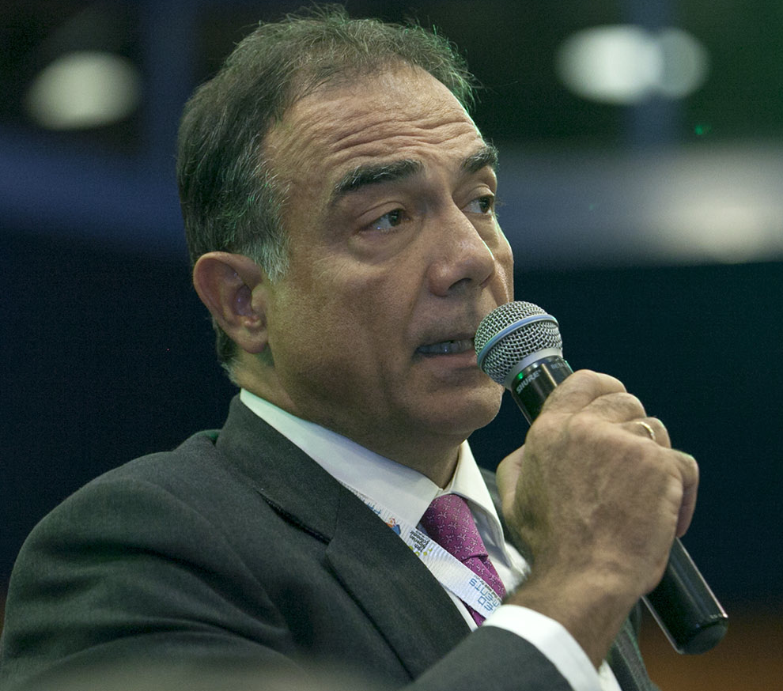

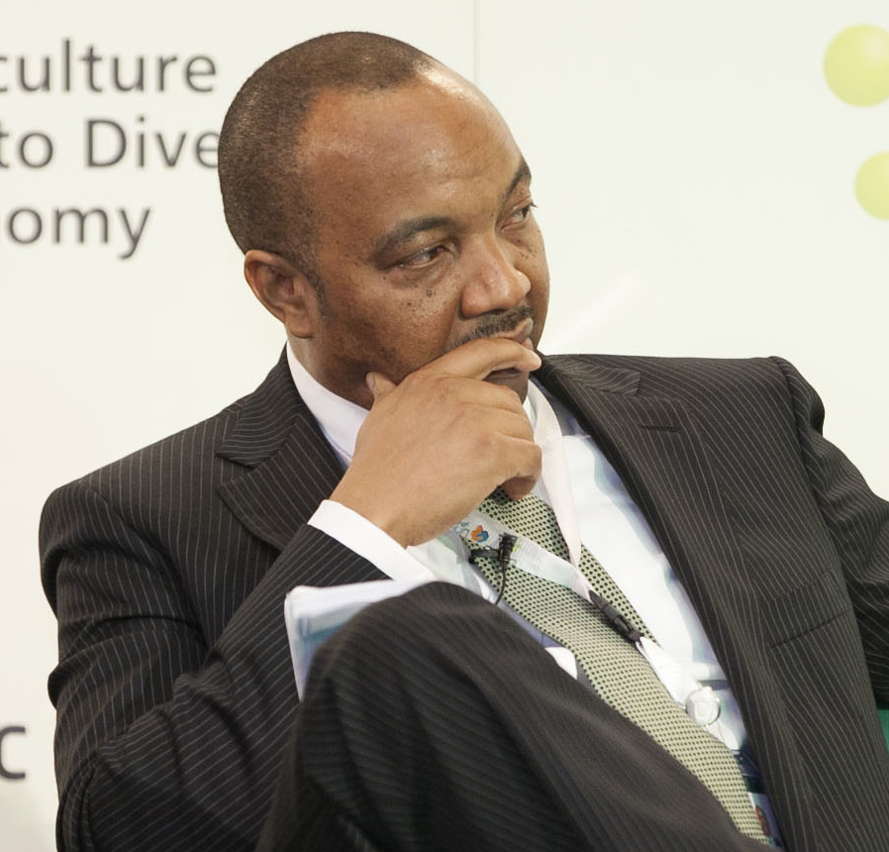
“We Have Gone Back to the Farm”
Nigeria’s Business Magnates Are Aggressively Moving Into Agriculture
46

Slide 48


