Slide 1


#DIGITEST2018
DIGITEST: SHOWCASING DIGITAL EXCELLENCE Amongst YOUTHs

Slide 2

#DIGITEST2018
DIGITEST is an annual ICT-based creative camp and competition for children, where young people are taught to develop contents on the internet, work with & develop various applications with emphasis on the development of quality youth leadership, promotion of role models on youth issues and inculcating godly values in children.

Slide 3
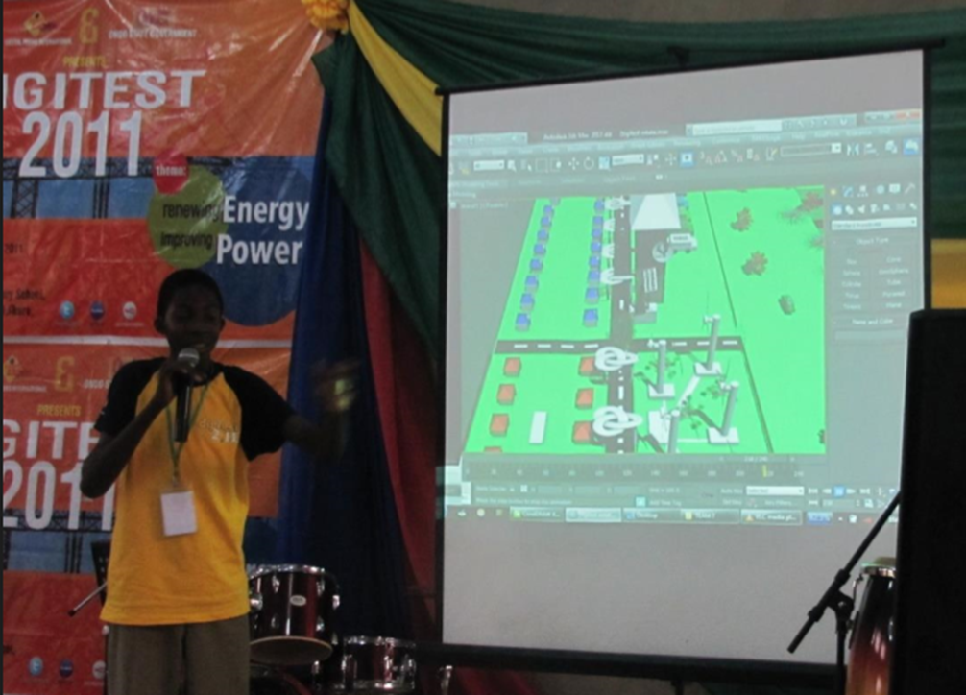
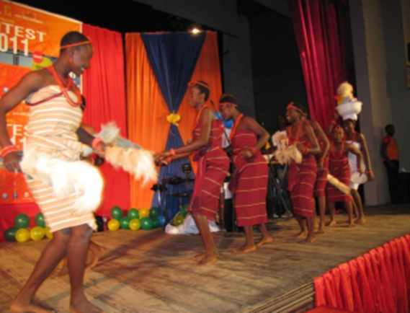
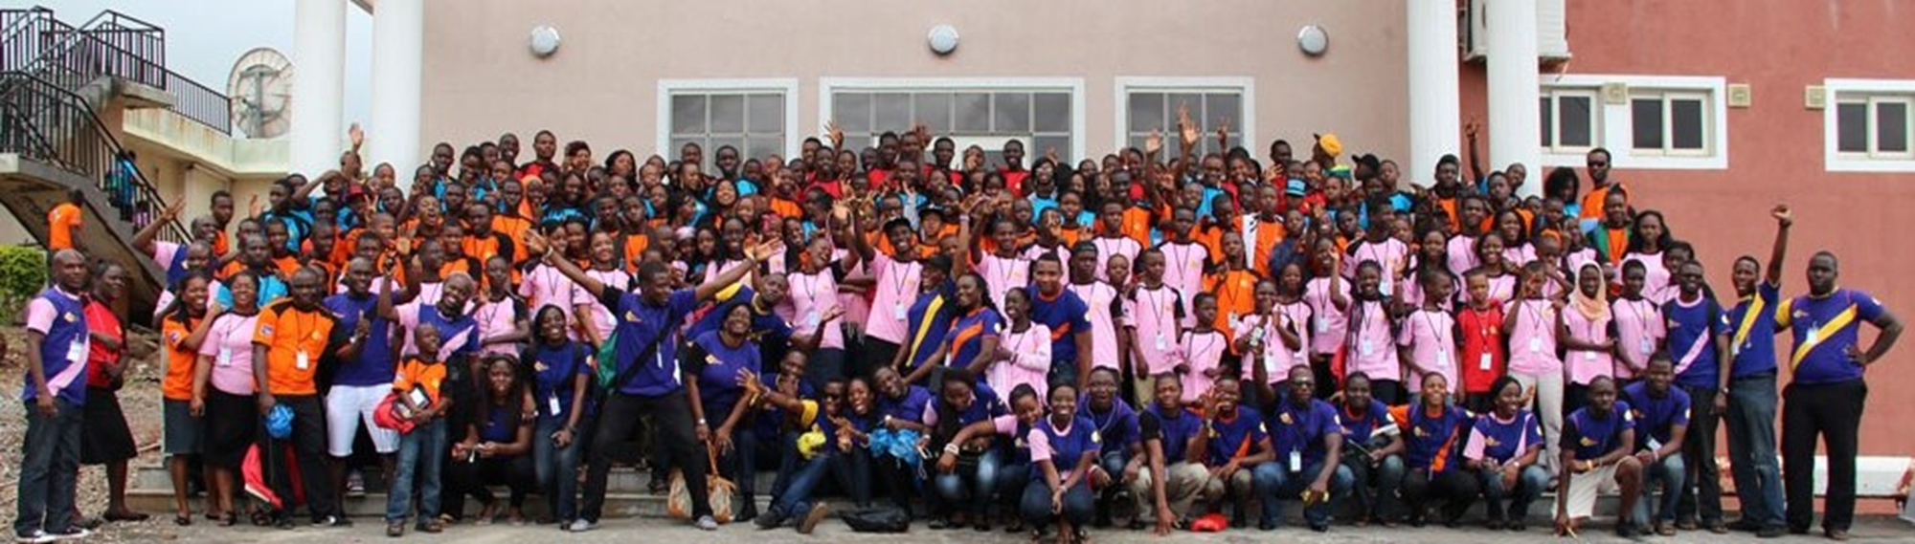

Slide 4
#DIGITEST2018
DIGITEST is a two-week camp that combines academics with social networking through social activities such as Sports, intellectual Debates on topical issues, Beauty Pageant and Tourism for young people ages 8-18 years and teachers from all over Africa.
Since inception in year 2000, a theme is selected for the program, with the aim of proffering solution to specific issues concerning the nation. This year, the theme for DIGITEST 2018 is – ‘Selling Without Borders’, with major focus on Digital Marketing and Renewable Energy, teaching participants valuable ways to utilize the social media space and ingenious methods of generating power using local materials.

Slide 5
#DIGITEST2018
ICT can solve national concerns, hence our focus over the years:
DIGITEST | Theme | Year
4th | Nipping HIV/AIDS in the bud | 2003
5th | Nigeria future without Corruption | 2004
6th | Achieving Food Security using IT | 2005
7th | Perfecting ICT with ICT | 2006
8th | Excellent governance through e-government | 2007
9th | e-business no barriers, no boundaries | 2008
10th | Raising I.T. champions for 2020 | 2009
11th | Going green digitally | 2010
12th | Renewing energy, improving Power | 2011
13th | Digital solutions to Youth Unemployment | 2012
14th | ICT Key for transformation | 2013
15th | Agricultural transformation using ICT | 2014

Slide 6
#DIGITEST2018
Reach-Out for More With New Partnerships
Sponsor 10 underprivileged young people from each geo-political zone of Nigeria and or encourage people within your circle of influence to register their children for DIGITEST 2018.
Your organization can Engage the over 400 DIGITEST participants for 2 hours in Obafemi Awolowo University.
You can save the future today, by letting us put your rich content on the DIGITEST 2018 Magazine that arguably reaches every part Nigeria and some parts of the globe.
Your partnership will help DPI strengthen the Schools based clubs called DIGIPALS and also enable a wider coverage in DPI’s grassroots penetration goal.

Slide 7
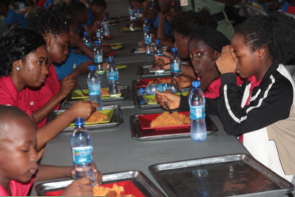
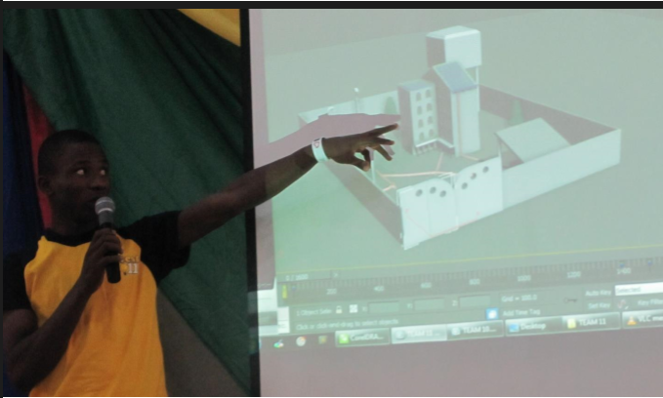
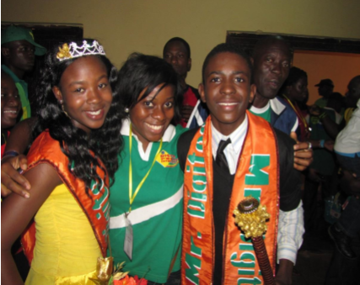

Slide 8
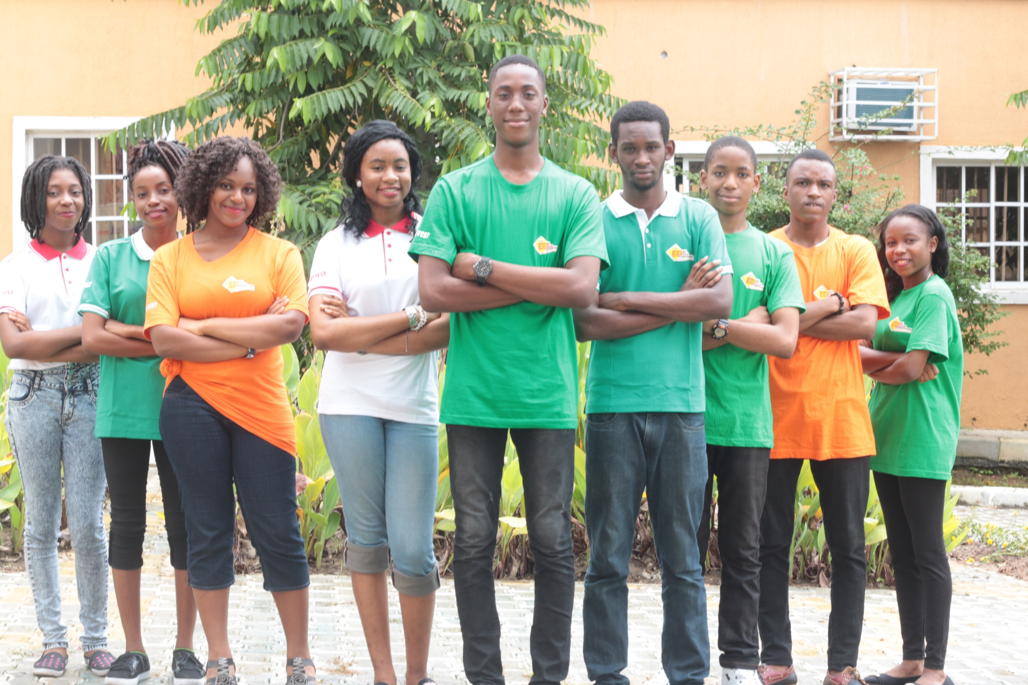
#DIGITEST2018
Contact Us
Tel: +2348077823307
+234 807 7823 308
dpi@digitalpeers.org
www.digitalpeers.org
Social Media Handles
Instagram @DigitalPeers
Facebook @DigitalPeers
Twitter @DigitalPeers
YouTube @dpidigitest

