Slide 1
New Cash Policy
Cashless Lagos Implementation
November 2011

Slide 2
Outline
  Context – Shared Services Program
  Overview & Implications of Nigeria’s Cash Economy
  Cash-Less Lagos
  Are you ready?
  Regulating Payment System – What Issues?

Slide 3
Overview: CBN, in conjunction with the Banker’s committee embarked on a Shared Services program with three key objectives, including a drastic cost reduction of 30%
Shared Services Program
Cash Management
Payment Systems Transformation*
IT Infrastructure & Services
IT Standards
Back Office Operations
  Industrialize Cash Management & Logistics (Storage, Processing & Movement)
  Facilitate growth of electronic payments
  Increase availability, reliability and security of electronic channels
  Increase efficiency and reduce cost of operations/maintenance for IT and infrastructure (application management, data centre, shared network, shared power, etc)
  Align IT standards across the Industry to improve efficiency, while driving data integrity and enabling information exchange
  Enable cost reduction through shared back office operations (centralized processing, collections; etc)
1
  Reduce Industry cost-to-serve by 30%
2
  Increase access, convenience and service levels across the Industry
3
  Enable greater financial inclusion and integration of financial services into the economy, with its attendant positive impact on economic development
NIBSS Transformation
CBN Process Re-Engineering
  * Payments is the key driver of cost of distribution, which accounts for almost 60% of the industry cost base
Notes:
3

Slide 4
Cost of cash to Nigeria’s financial system is high and increasing. In fact, direct cost of cash is estimated to reach N192 billion in 2012
Direct cost* of cash to Financial system (2009)
A 5-year projection of the direct cost of cash to Financial System
Cash in Transit
Cost (24%)
N27.3bn
Cost of Cash (CBN + Banks)
Cash Processing Cost (67%)
Annual Total Cost (NBn)
N69.1bn
N114.5bn
Vault Management Cost (9%)
N18.1bn*
2008 2009 2010 2011 2012
Source: A compilation of actual data from the CBN and17 banks in the FSI (data extrapolated for 24 Banks).
*Does not include bank cash infrastructure costs and employee costs attributable to cash logistics

Slide 5
Nigeria is a cash based economy with retail and commercial payments primarily made in cash
Cash related transactions represent over 99% of customer activity in Nigerian banks today.
Payment Channel | Transaction Volume
ATM Withdrawals | 109,592,646
OTC Cash Withdrawals | 72,499,812*
Cheques | 29,159,960
POS | 1,059,069
Web | 2,703,516

Slide 6
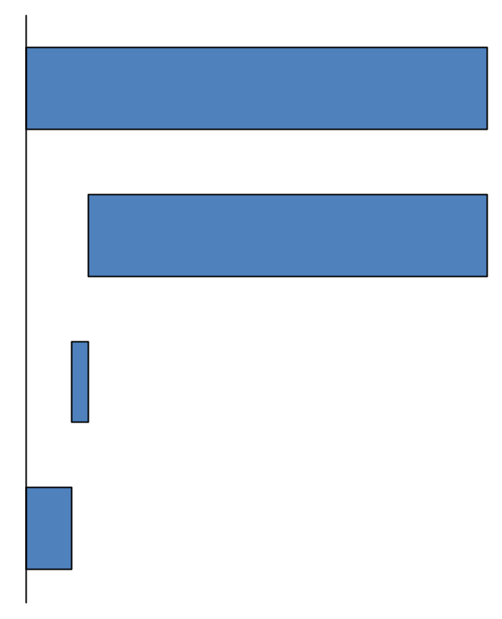
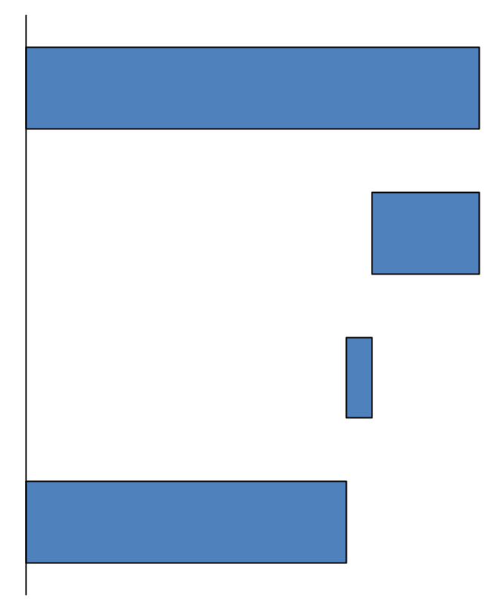
However, only 10% of branch cash transactions are above N150,000, but they make up ~71% of the value of cash transactions
Branch Cash transactions– number of transactions
Branch cash transactions - value of transcations(N’Bn)
Total
100%
2,076
0-100,000
86%
491
100,001-150,000
4%
115
150,001 and above
10%
1469
10% of number of cash transactions are above N150,000
But accounts for 71% in value of cash transactions
* Base data is reflective of the Nigerian Banking Industry

Slide 7
In addition, the high usage of cash results in a number of challenges across the system
  Example of challenges resulting from high-cash usage (Not Exhaustive)
  Robberies and cash-related crime
  High cost of processing borne by every entity across the value chain (i.e. from CBN, to Banks, to the operating entities as well (e.g. staff required to process cash transactions, manual operating systems, etc))
  Revenue leakage arising from significant handling of cash
  Inefficient treasury management due to nature of cash processing
Notes:
7

Slide 8
To address these challenges, the Cash policy was introduced to encourage cashless payments, while ensuring not all consumers subsidize the few ‘heavy cash’ users
  Key Components of Cash Policy Circular
  Implications & Priorities
  Commencing from June 1, 2012, a daily cumulative limit of N150,000 and N1,000,000 on free cash withdrawals and lodgments by
  individual and corporate customers respectively
  Individuals and corporate organizations that make cash transactions above the limits will be charged a penal fee of N100/thousand and N200/thousand respectively for amounts above the cumulative limits.
  Furthermore, 3rd party cheques above N150,000 shall not be eligible for encashment over the counter. Value for such cheques shall be received through the clearing house.
  Banks will cease cash in transit lodgment services rendered to merchant-customers from June 1, 2012 (to be replaced by CBN licensed CIT providers)
  No card scheme shall operate exclusive acquirer agreement or contract in Nigeria with effect from June 1, 2011
  Increasing availability and reliability of alternative payment channels; as well as ensuring effective settlement cycles
  Ensuring appropriate options to enable addition of ‘new entrants’ into the banking system (e.g. KYC requirements)
  Educating and creating awareness amongst consumers, merchants, other stakeholders
  Instituting a framework to ensure monitoring and compliance of policy; mitigate risks; as well as assess the impact on economy and industry cost-to-serve
Notes:
8

Slide 9
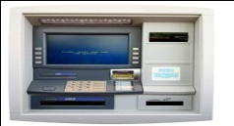
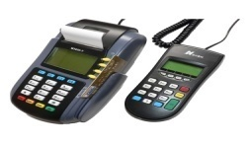
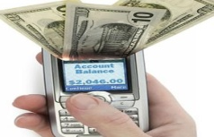

“Cashless Lagos” is the cross-industry collaborative effort executing the payments transformation plan in Lagos state
GOALS:
  Implement new cash policy and demonstrate Feasibility/Benefits
  Significantly increase POS penetration and usage
  Significantly push awareness and usage of other electronic channels (e.g. Direct Debit, Electronic Funds Transfer, Mobile payments, ATMs etc)
CBN
Banks
Lagos State
Govt.
Switches/
Processors
Cashless
Lagos
NIBSS
Telecom
Providers
Merchants/
Consumers
POS
Manufacturers
Go-live date of
January 1st 2012

Slide 10
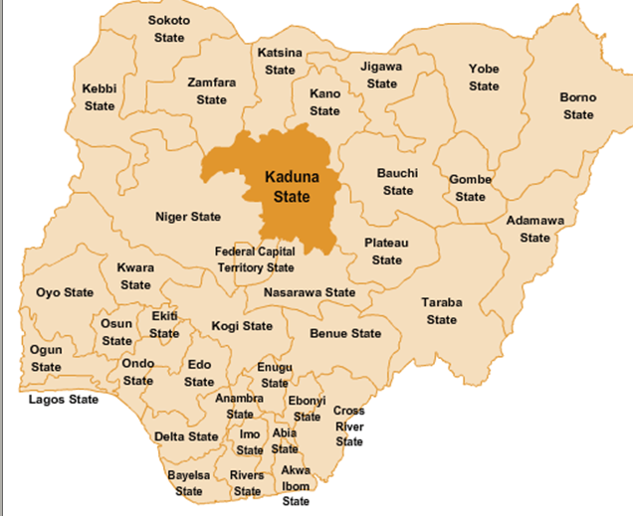
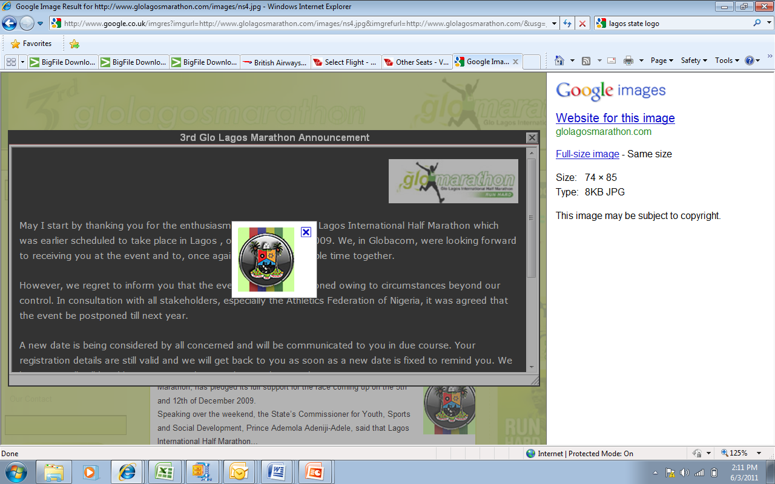
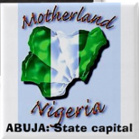
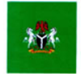
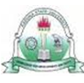
Why Lagos? - Lagos is ahead of other States in terms of banking penetration and payment infrastructure
Lagos accounts for 85% of POS transactions; and ~66% of cheques*
# of POS per
100,000 people
# of branches per 100,000 people
# of ATMs per 100,000 people
Population (m)
Rest of Nigeria
119
* 2009 Data

Slide 11


Cashless Lagos: Alternatives to cash will be made available for both retail and wholesale cash users
  Industry stakeholders are jointly working together to increase the alternative channel penetration, functionality, and ease-of-use
  Point-Of-Sale Systems: Card Neutral (Interoperability); Improved Connectivity; Greater reach/deployment, T+1 settlement
  Mobile Payments: Eleven players fully licensed; few others in pilot mode
  Multi-functional ATMs: Withdrawal, Cash-deposit, Bill payments, etc
  Internet Banking: Intra and Inter Bank funds transfer
  (Instant) Electronic Funds Transfer: Instant transfer option currently offered through NIBSS
  Direct Debits: Automated Direct Debit option being piloted with a few Banks and Billers

Slide 12
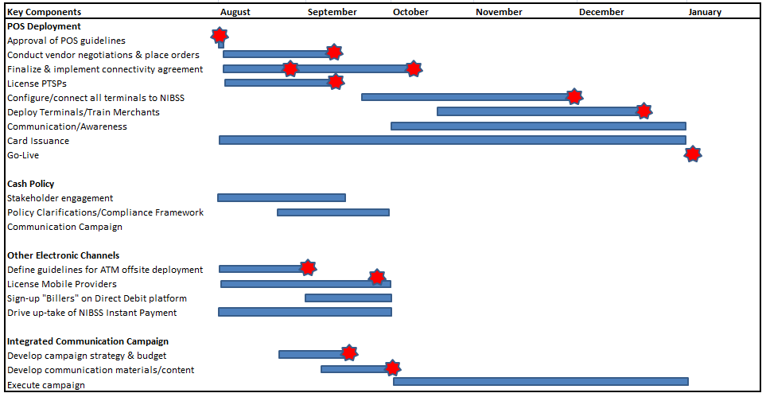
Cashless Lagos: Work has commenced in earnest, with clear milestones defined in four key areas
High-Level Roadmap for Cashless Lagos (Key Milestones)
1
2
3
4

Slide 13




Significant opportunities exist for various stakeholders
  Stakeholders
  Expected Benefits
  Areas to support (not exhaustive)
Government
  Optimize tax revenue collection
  Increased economic growth (positive correlation with increased payment efficiency)
  Increased financial inclusion
  Tax incentives to drive adoption of electronic payments
  Laws to support electronic processing & payments
  Continued support of E-payments drive through own internal processes
Consumers
  Faster, easier payments
  Increased convenience/access (more payment options)
  Reduced risk of robbery
  Consumer sensitization & awareness
  Consumer education – knowledge of their rights
  Feedback forums to regularly engage various customer segments and monitor quality of dispute resolution
Corporations
  Better access to capital due to shorter payment processing times
  Increased efficiency of payment processes and accounting
  Reduced revenue leakages
  More efficient treasury management
  Embrace alternative channels – for internal use and dealing with 3rd parties (proactively engage banks on solutions; electronic bill payments, etc)
  Sign-up for Direct Debit (where applicable)
  Transfer some of efficiency benefits to customers via incentives to encourage e-channels
Banks
  Efficiency through electronic payment processing
  Reduced cost of operations (cash handling)
  Increased banking penetration
  Increase availability, functionality, and dispute resolution process for e-channel solutions
  Begin customer engagement on alternative platforms now & participate in engagement sessions
  Order POS terminals & source merchants
  Leverage NIBSS service offerings

Slide 14
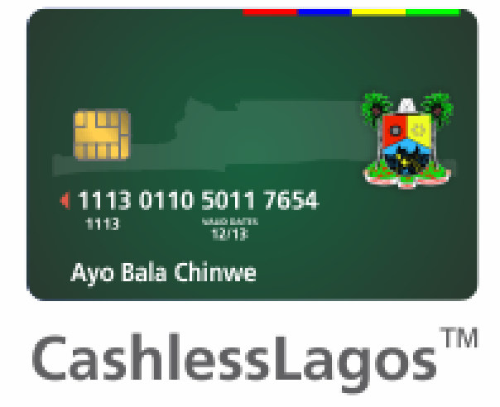
Are you ready for Cashless Lagos?
Notes:
14

Slide 15
Initial Ideas - How you can support…..
(not exhaustive)
As Individuals....
As a Parastatal.....
  Sign-up for a Debit Card with your bank today! (Various types, many benefits)
  Use your card for payments – ask merchants for their card options
  Sign-up for electronic products (Internet Banking, Mobile Banking, etc)
  Inform and educate your circle of influence – spread the word!
  Other ideas????
  Electronic payments (Salaries)?
  Provide customers with electronic options for payments to you (discourage use of cash payments – e.g. cash limits)
  Pay your contractors/3rd parties electronically
  Other ideas????

Slide 16
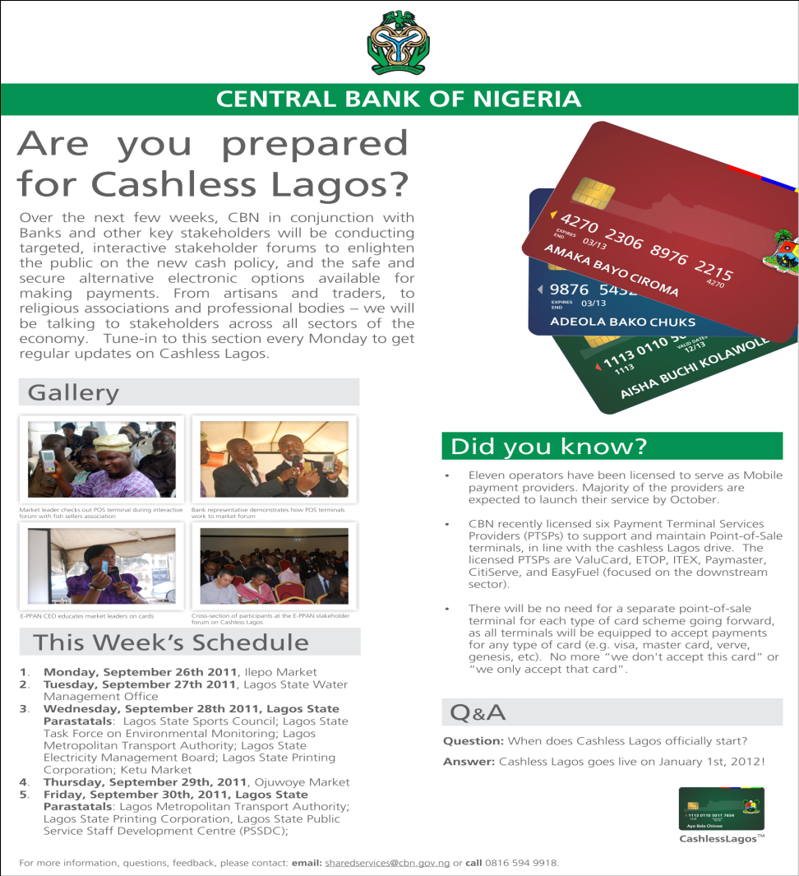
Stay informed with our weekly Monday Column
Every Monday – ThisDay, Punch, BusinessDay
Notes:
16

Slide 17
Regulating Payment Systems –What Issues? (1)
Pure Contractual Rules-How adequate? Will it engender trust and confidence?
The cost of contracting around inefficient rules-What quantum?
The narrow scope and coverage of extant rules and regulations
Efforts at emplacing fraud prevention method-How strong?
The challenge of not having dedicated payment system law and regulations focusing on consumer protection?
The challenge of efficient risk allocation including the risk of fraud.

Slide 18
Regulating Payment Systems –What Issues? (2)
Banks role in fraud detection and deterrence measures-what should it be?
What disclosures are relevant and necessary before payment is made?
What is ‘error’? When is error not fraud in a payment system? How is error resolved?
Any limitation for liability for fraud?
Clarification on the issues of consent; payment verification instrument

Slide 19
Regulating Payment Systems –What Issues? (3)
The Issue of payment system when Electronic i.e.
- Legal and Regulatory challenges in E-payment.
- Credit Card-Legal Issues between holder, Issuer and Supplier..
- The Challenge of IT security- computer crime/cybercrime-IT security and criminality e.g. Hacking, Cracking, Advanced Fee Fraud (419) and fraud.
- Data Protection and Privacy Issues –The issue of confidentiality
- The Challenge of identity especially when transaction is electronic and the issue of Digital Signature.
- Legal Issues in E-money
- Mobile Payment system

Slide 20
THANK YOU
FOR LISTENING!
Notes:
20

